Slide 1
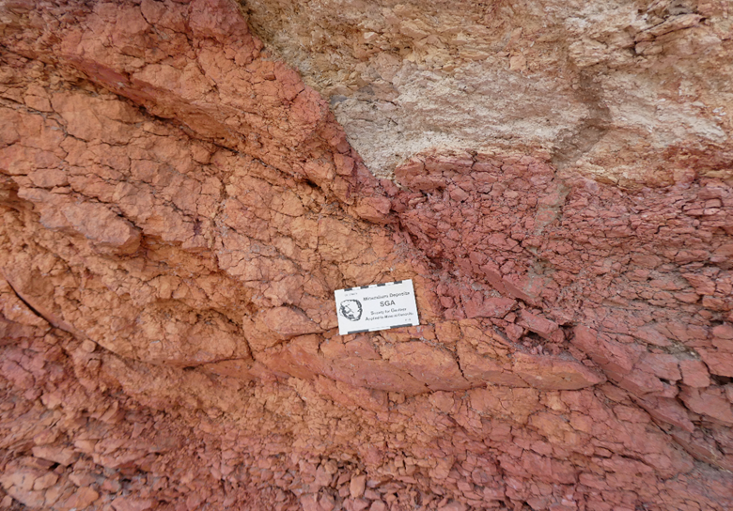
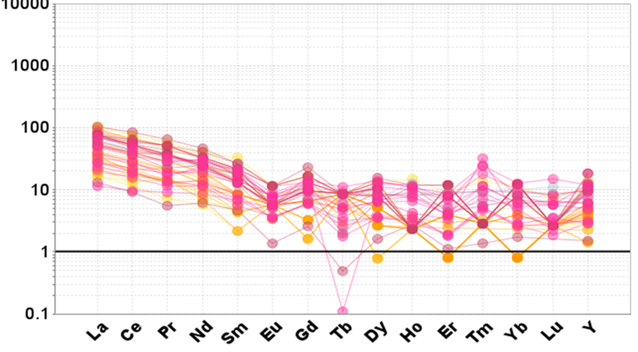
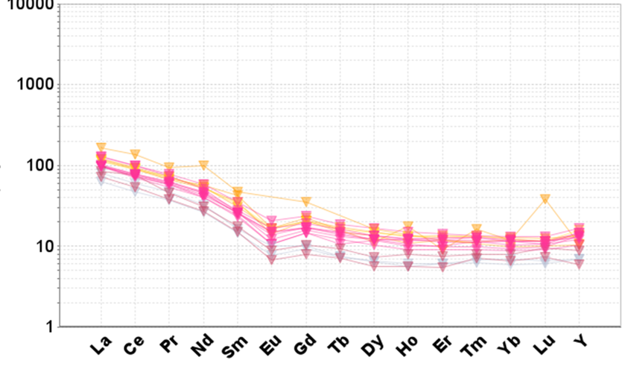
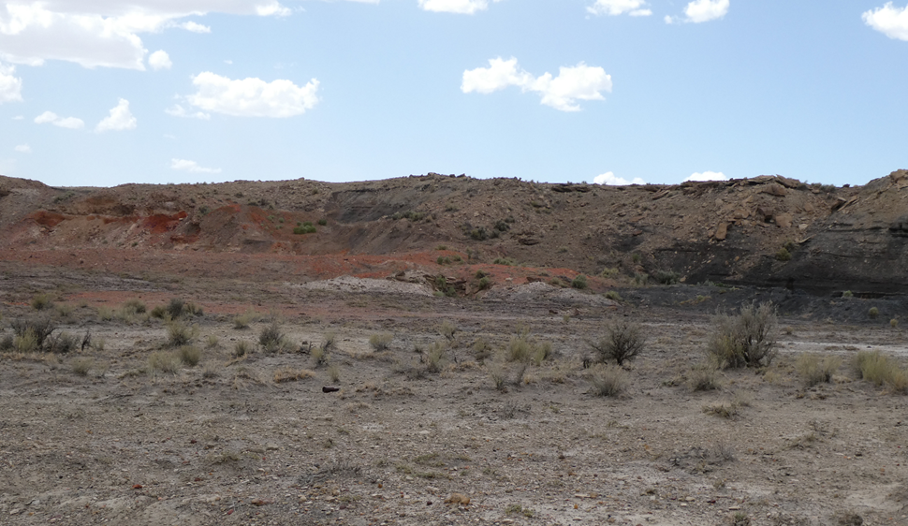
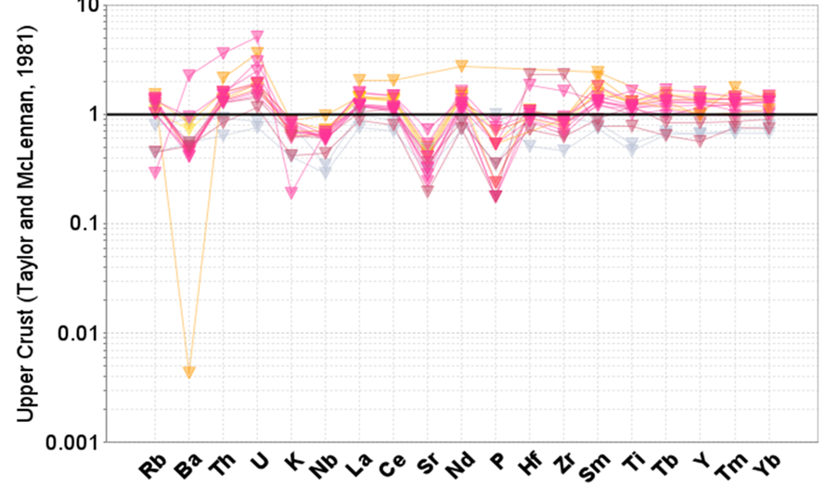
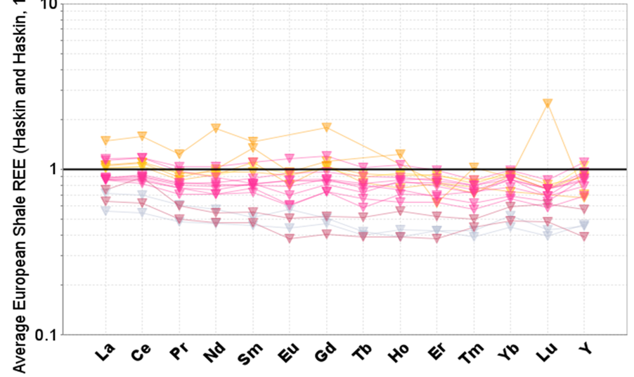
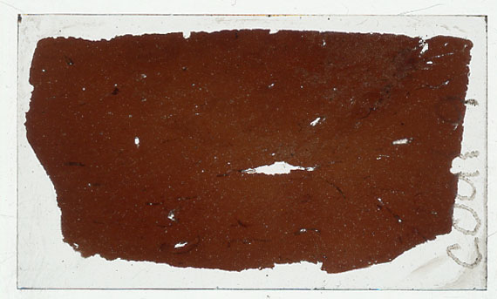
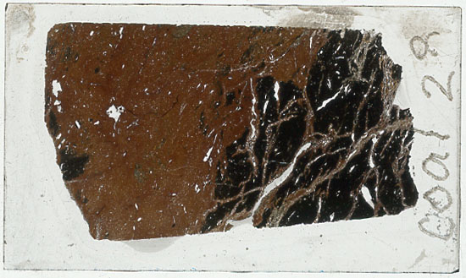
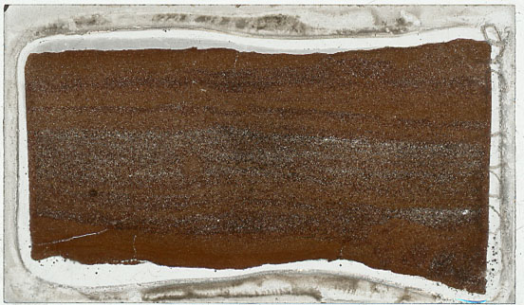
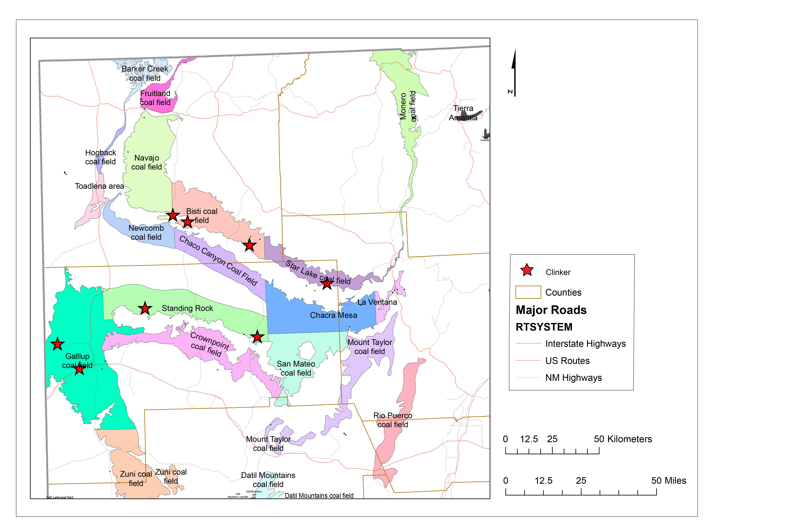
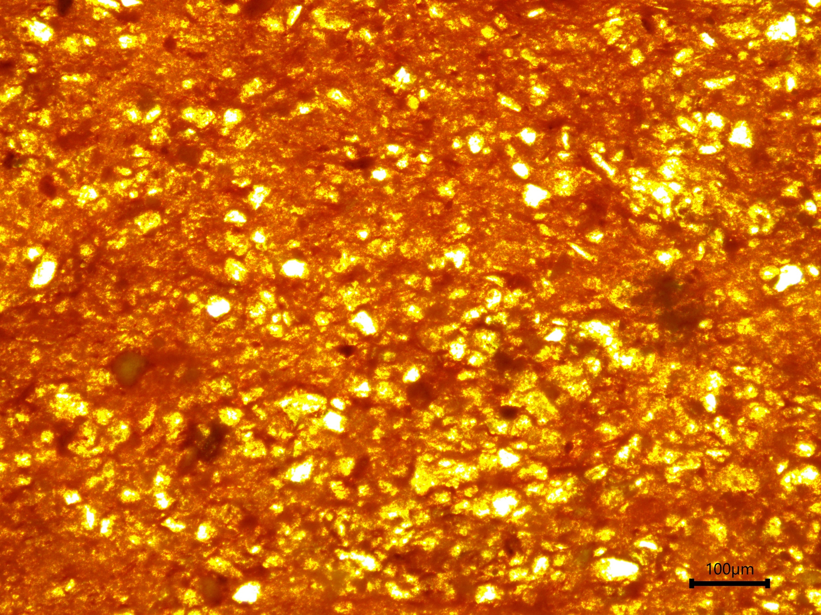
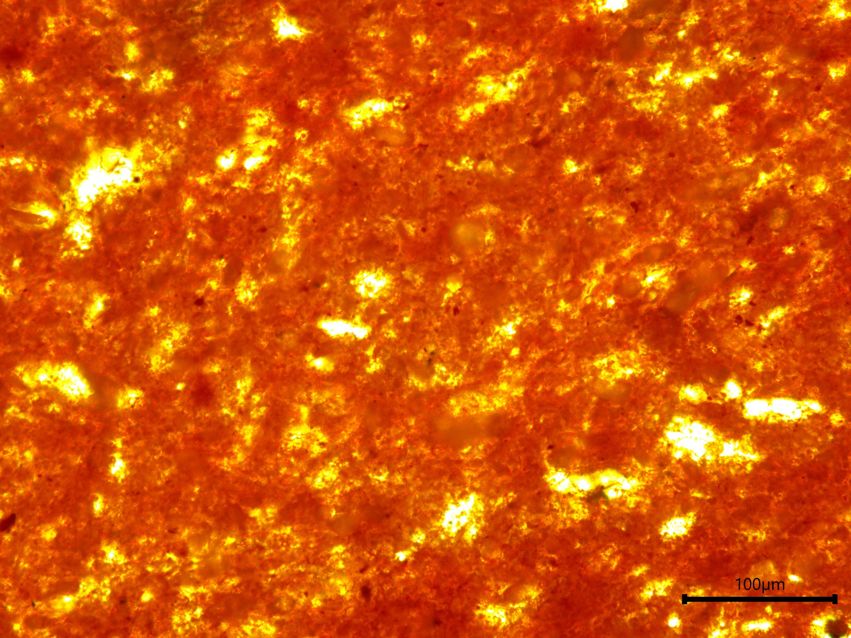
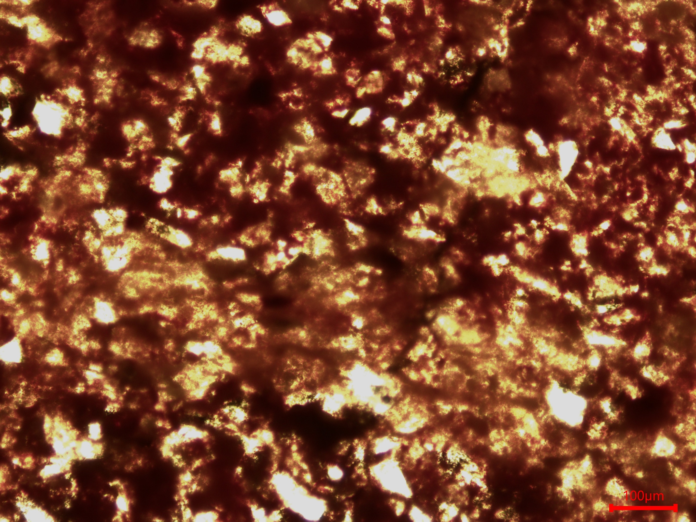
Alteration and Geochemistry of Clinkers in the San Juan Basin, New Mexico
Devlon R. Shaver¹, Virginia T. McLemore², and Evan J. Owen²
¹Department of Mineral Engineering, New Mexico Institute of Mining and Technology, Socorro, New Mexico 87801
²New Mexico Bureau of Geology and Mineral Resources, New Mexico Institute of Mining and Technology, Socorro, New Mexico 87801
Abstract
Clinkers are the result of coal seam fires that alter adjacent strata into rocks with a generally red/orange, brick-like appearance. Coal seam fires burn at temperatures of over 500 degrees C, causing the surrounding rock and minerals within, to be altered, fused, or even melted. Clinker gets its name from the ringing sound it makes when struck, due to glassy, pyro metamorphosed minerals within the rock. Clinkers can be composed of various sedimentary rocks that were bedded with the coal seams during the burning process and include shales, claystone-s, and sandstones. These rocks impart different textures and affect the geochemical compositions of the clinker. Most underground coal fires that result in clinker are caused by wildfires, lightning strikes, or even heat from the oxidation of pyrite or marcasite contained in coal igniting exposed coal seams. Clinker is used as an aggregate in road construction, and is also used in glass production, refractories, and as a soil amendment. Chemical analysis of neighboring unburned coal deposits with a similar composition to the pre-burned clinker would provide insight into whether critical minerals including rare earth elements (REE) have been concentrated, depleted, or altered during the clinker formation. With the recent interest in charactering coal wastes such as ash for their critical mineral potential, trace element chemistry would show if clinkers could be a potential source of critical minerals. All of our samples are from the San Juan Basin in northwestern New Mexico as no clinker deposits are found in the Raton Basin. Comparing the REE profiles of clinker to standards such as average European shale show that the pyro-metamorphosis of coal and adjacent strata into clinker has not caused any significant variation in the concentration of REE. REE in clinkers range from 105-306 ppm total REE. Some samples contain elevated Fe₂O₃ concentrations (>50%) as well as elevated P₂O₅ (0.03-0.17% P₂O₅) concentrations. Only a small number of samples are currently available for analysis and petrographic study, additional samples are needed for more definitive interpretations.
Clinker Chemistry
11 samples of clinkers have been analyzed chemically to date. No potentially economic levels of critical minerals, such as rare earth elements (REE), have been observed so far. Clinkers show slightly elevated REE content compared to chondritic values, with light REE enrichment. REE values in clinkers are similar to coal and related strata.
Clinkers show similar concentrations of elements in the average upper crust sediments. The strong negative Ba anomaly in one sample likely reflects laboratory error. Clinkers show minimal enrichment or depletion in REE compared to Average European Shale.
These data suggest that clinker formation does not significantly affect REE content in the resulting clinker.
A
A
Coal
B
Clinker
B
Sample/chondrite
Sample/chondrite
Chondrite normalized REE diagrams of coal (A) and clinker (B) showing LREE enriched profiles.
Description:
Clinkers are sedimentary rocks that surround coals that caught fire at the surface, through numerous possible causes, and then burned underground. The intense heat from the burning coal would bake the surrounding rock layers, pyrometamorphosing them. This would burn away the organic material, allowing the iron in the rocks to oxidize, and causing glasses to form in the rock, giving clinker its trademark red/orange appearance and sound. Clinkers are most commonly made up of clays, mudstones, and sandstones that were bedded alongside the coal seam.
A
B
A: Variation in color across a clinker seam appears to correlate with a difference in grain size. Lighter red/orange (left) is finer grained than the darker red (right) (Sample COAL9f)
B: Transition between clinker (left) and coal (right).
Preliminary conclusions
Clinker formation did not significantly change the concentrations of REE in clinker compared to the unaltered rock. Clinkers do not show potentially economic concentrations of REE and other CM to date. Light REE chondrite normalized pattern suggests that REE present may be hosted by clay minerals or very fine-grained REE minerals.
Sample/average upper crust sediments
Sample/Average European Shale
Purpose
The purpose of this project is to explore the mineralogy and chemistry of clinkers in the San Juan Basin and to evaluate clinkers for potentially recoverable critical minerals and REE.
A: Clinker chemistry normalized to average upper crust sediment values. B: Clinker REE concentrations normalized to Average European Shale showing that REE are not enriched or depleted compared to standard values.
Acknowledgements
This report is part of ongoing studies of mineral resources in New Mexico, supported by the New Mexico Bureau of Geology and Mineral Resources (NMBGMR), Nelia Dunbar, Director and State Geologist. Current research is funded through a DOE grant Carbon ore, rare earth, and CM (CORE-CM) assessment of San Juan River-Raton Coal Basin, New Mexico, DE-FE0032051Field work on the Navajo Nation was conducted under a permit from the Minerals Department. Any persons wishing to conduct geologic investigations on the Navajo Nation must first apply for and receive a permit from the Minerals Department, P.O. Box 1910, Window Rock, Arizona 6515 and telephone no. 928-871-6588. Special thanks to Ginger’s economic geology group and others in sample collection and organization.
Methods
The methods used in this study are:
Sample collection
Rock chemistry
Petrography
Microprobe
X-Ray Diffraction (XRD)
Petrography of clinkers
Location of clinker deposits in the coal fields of the San Juan Basin, northwestern New Mexico.
References
1. Laita, E., Bauluz, B., &amp; Yuste, A. (2019). High-temperature mineral phases generated in natural clinkers by spontaneous combustion of coal. Minerals, 9(4), 213. https://doi.org/10.3390/min9040213
2. Heffern, E. L., &amp; Coates, D. A. (2004). Geologic history of natural coal-bed fires, Powder River Basin, USA. International Journal of Coal Geology, 59(1-2), 25–47. https://doi.org/10.1016/j.coal.2003.07.002
3. Mining data solutions. (n.d.). Major Mines &amp; Projects: San juan mine. MDO. Retrieved February 17, 2023, from https://miningdataonline.com/property/3412/San-Juan-
4. Cosica, M. A., &amp; Essene, E. J. (1989). Pyrometamorphic rocks associated with naturally burned coal beds, Powder River basin, Wyoming. American Minerologist, 74(1), 85–100. Retrieved November 2, 2022, from https://pubs.geoscienceworld.org/msa/ammin/article-abstract/74/1-
5. Hoffman, G. K., Verploegh, J., and Barker, J. M., 1993, Geology and chemistry of humate deposits in the southern San Juan Basin, New Mexico: SME Annual Meeting, Albuquerque, Preprint 94-142, 10 p.
6. Austin, G. S., Hoffman, G. K., Barker, J. M., Zidek, J., &amp; Gilson, N. (n.d.). Proceedings of the 31st Forum on the Geology of Industrial Minerals— The Borderland Forum, 187. Retrieved February 20, 2023, from https://geoinfo.nmt.edu/publications/monographs/bulletins/downloads/154/B154.pdf
Thin section scan and photomicrograph of sample COAL9, a pyrometamorphosed mudstone with grains of quartz.
100 um
Thin section scan and photomicrograph of sample COAL28, a claystone/mudstone clinker containing more abundant clay minerals.
100 um
100 um
Thin section scan and photomicrograph of COAL36, which is a fine-grained quartz arenite rich in iron oxide. Bedding is defined by variations in grain size and quartz content.

