Slide 1
Quantitative Analysis
Quantitative analysis using the electron microprobe involves measuring the intensities of X-ray lines generated from your unknown sample, and comparing these to the same lines in suitable standards, using identical or similar instrumental conditions.

Slide 2
Quantitative WDS analysis
A simplified approximation of the principle of WDS analysis is as follows:
C_{A}(sp) = [I_{A}(sp)/I_{A}(st)]C_{A}(st)
Where
C_{A}(sp) = concentration in specimen
C_{A}(st) = concentration in standard
I_{A}(sp) = X-ray intensity in specimen
I_{A}(st) = X-ray intensity in standard
I_{A}(sp)/ I_{A}(st) is known as the K ratio

Slide 3
A number of factors are important components of quantitative analysis:
-Selection of suitable standards
-Selection of suitable crystals and order of analysis
-Choice of appropriate analytical conditions
-Background selection/correction
-Matrix corrections

Slide 4
Approach to WDS analysis
1. Choose appropriate standards for analysis.
-Good characteristics for standards??
-Pure elements can be unsuitable. High matrix corrections, chemical bonding effects, difficult to polish, oxidation, may not exist in natural form.
-Synthetic compounds can be used. Has the advantage of assured purity. Homogeneity on a very fine scale is desirable.
-Some natural minerals can be well characterized, or compositions can be determined from theoretical formulas and can be used as standards. Must be homogeneous.
-Well-characterized complex phases can be used as reference materials to verify calibration. Kakanui phases.

Slide 5
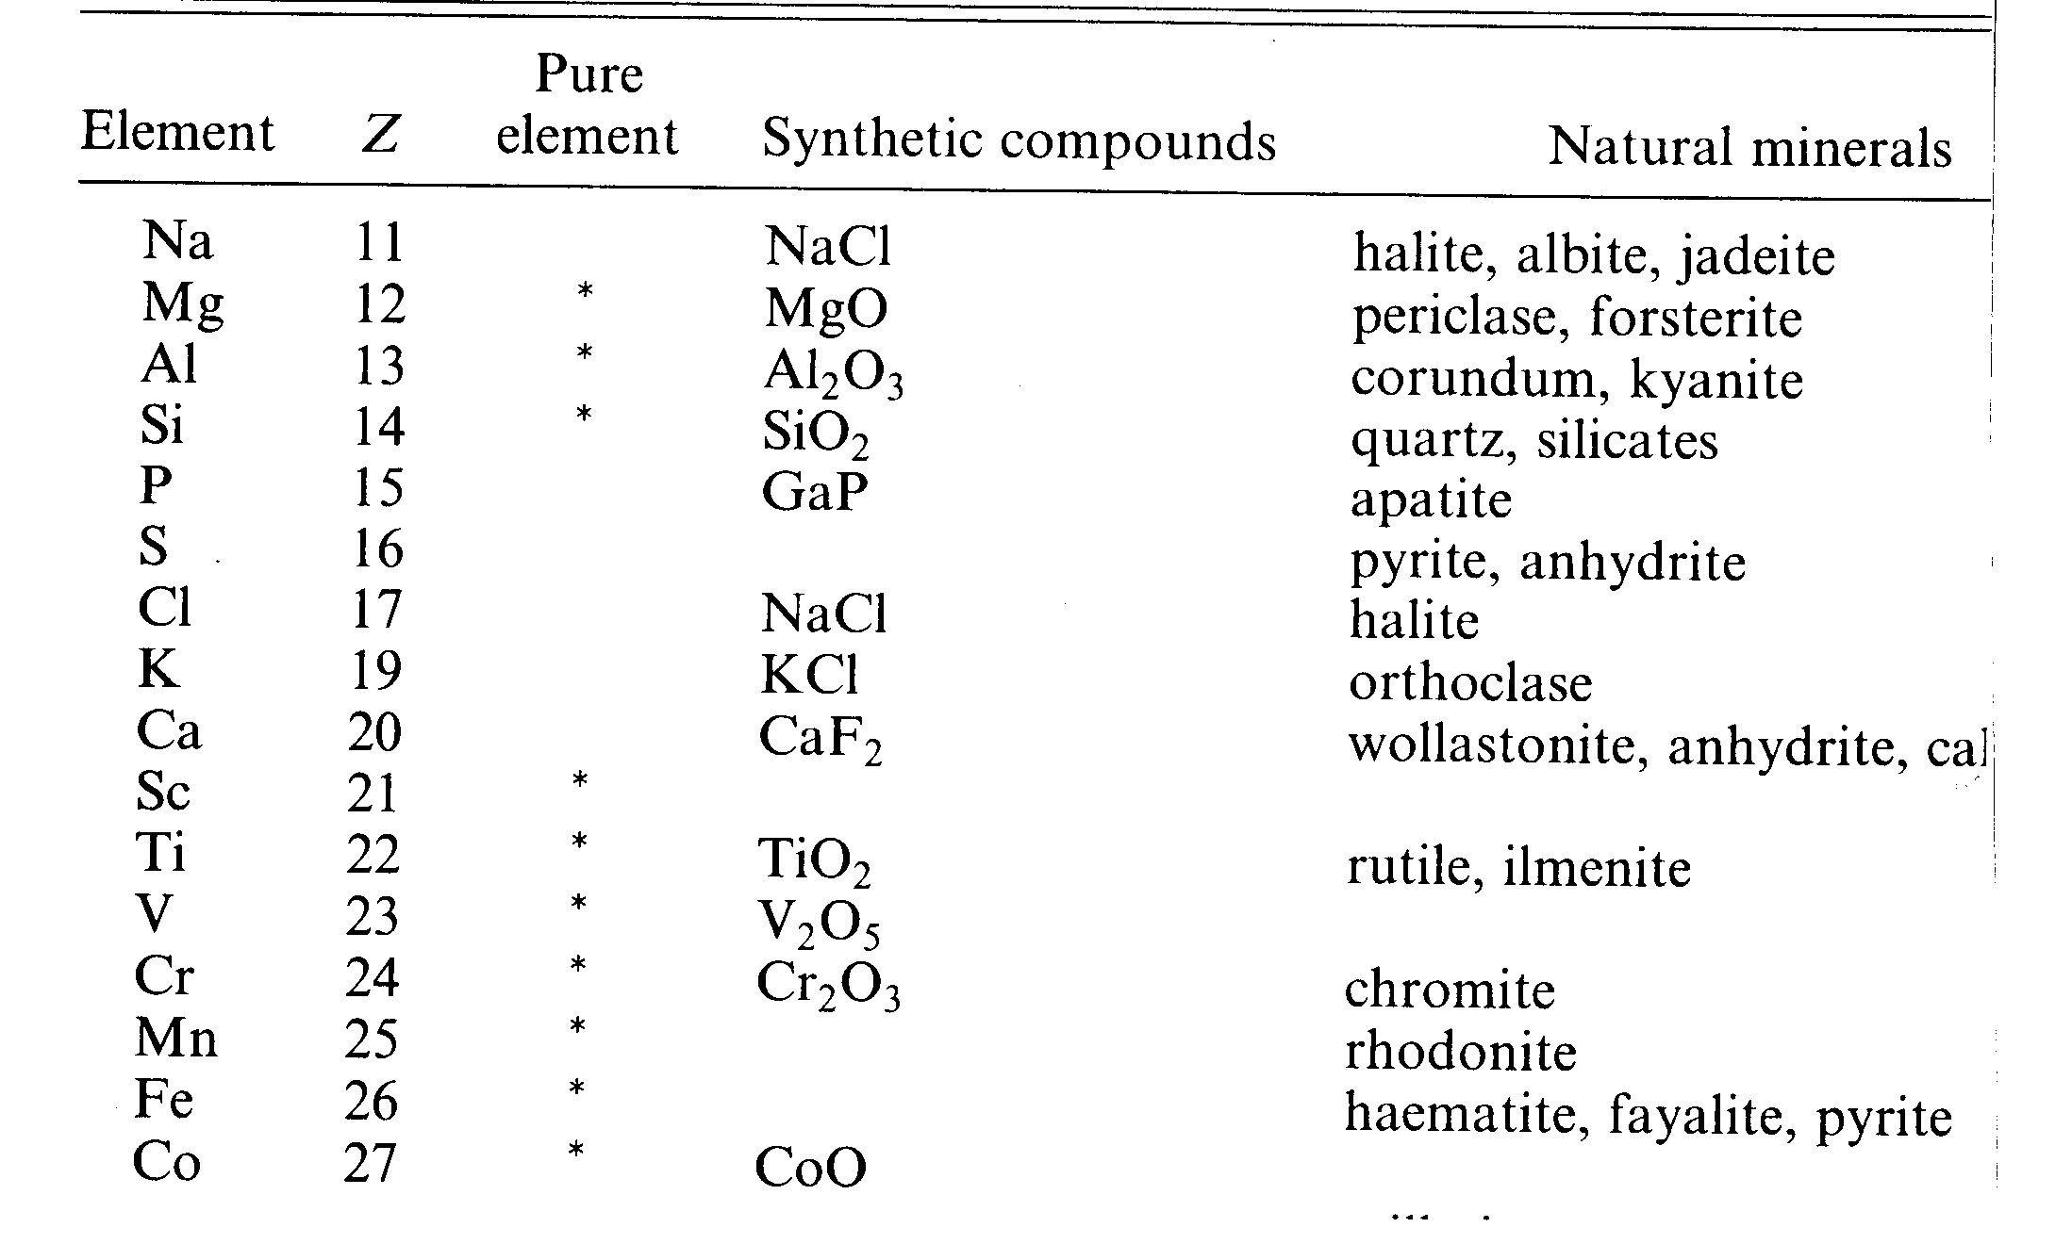

Slide 6
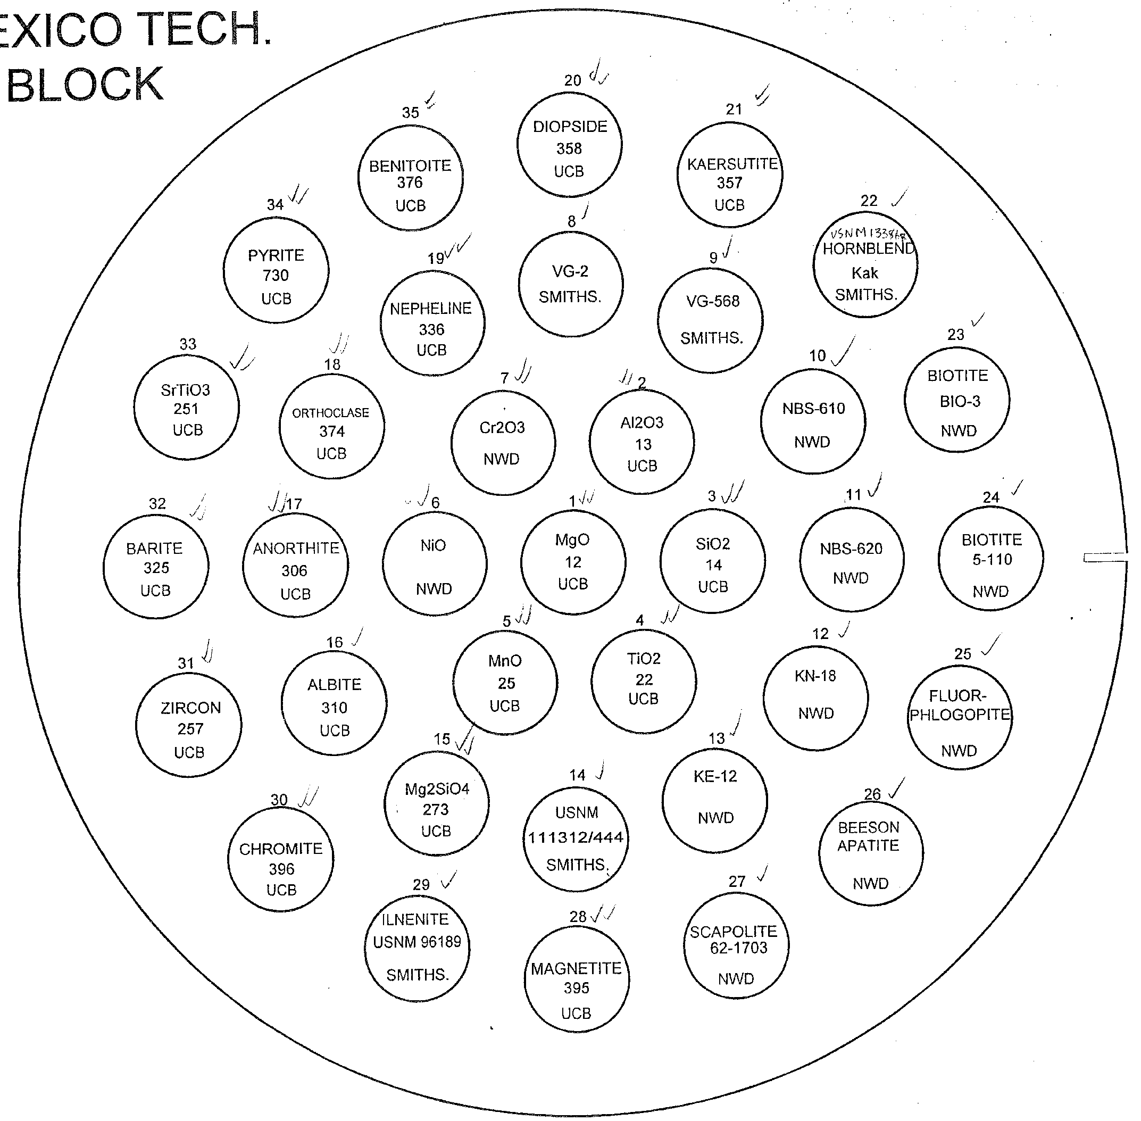

Slide 7
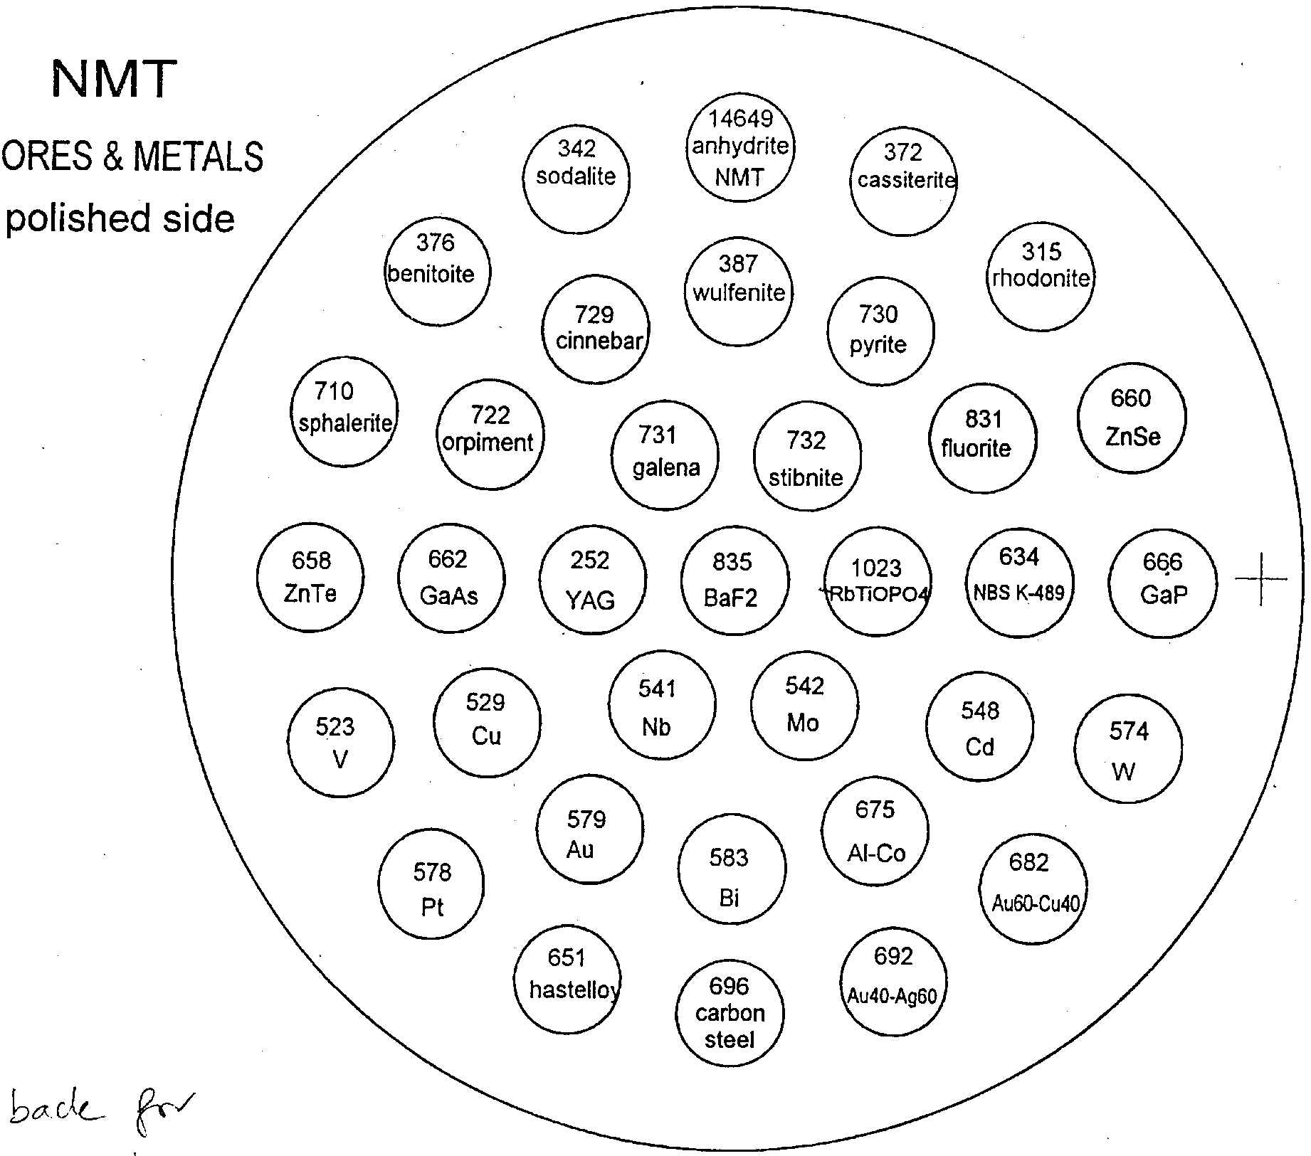

Slide 8
Carbonates and REE

Slide 9
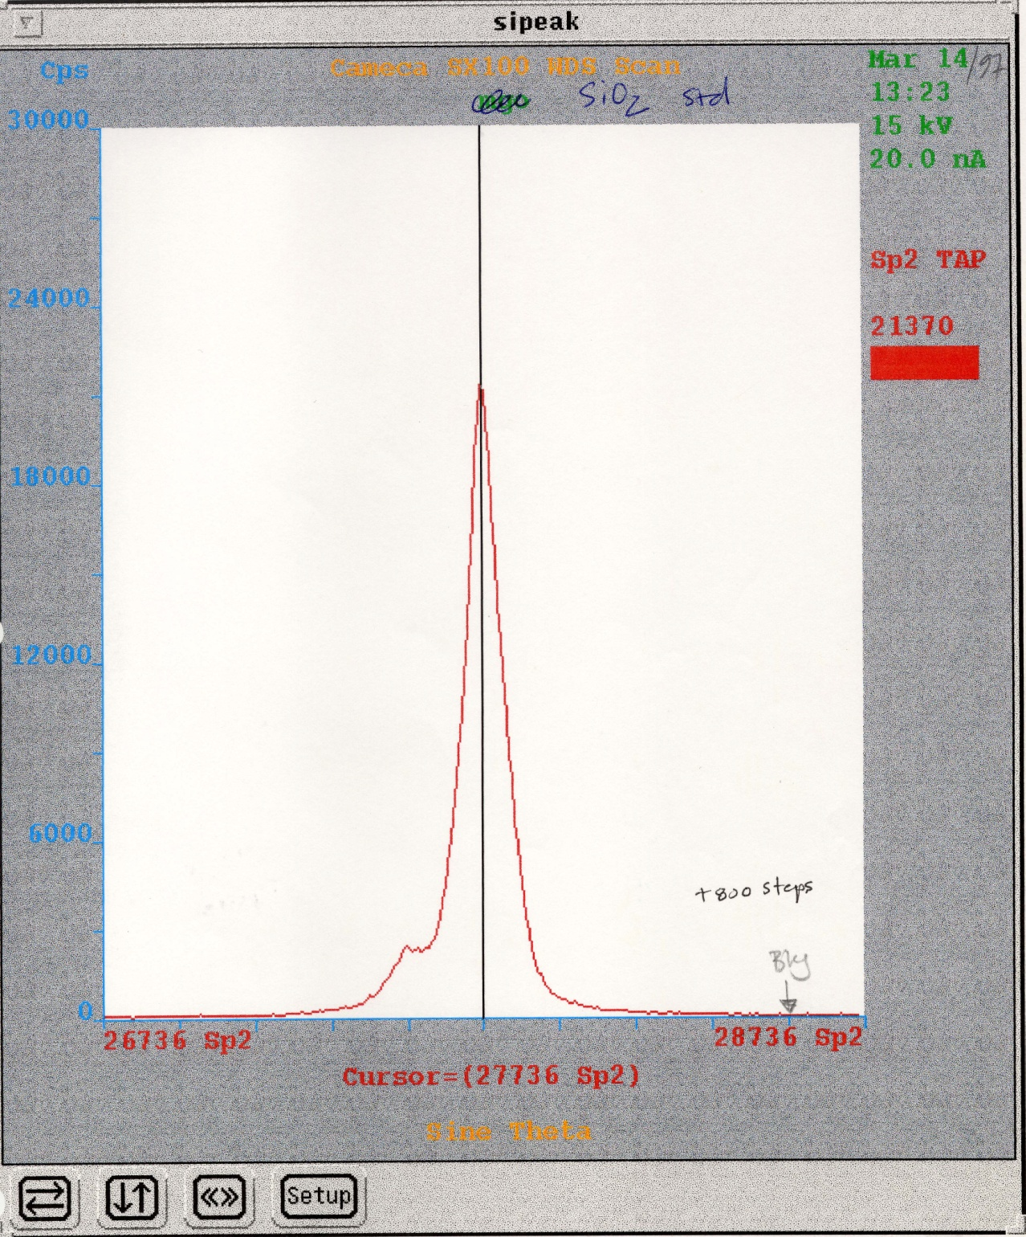

Slide 10
2. Peak search and choose appropriate background values.
-Measured peak intensities include a contribution from the background. This must be evaluated. Preferable to measure backgrounds on both sides of the peak, but can use one side only to save spectrometer wear.
-Problems can arise if standards have different backgrounds than unknowns (ie. Fe interference on F).

Slide 11
Simple peak

Slide 12
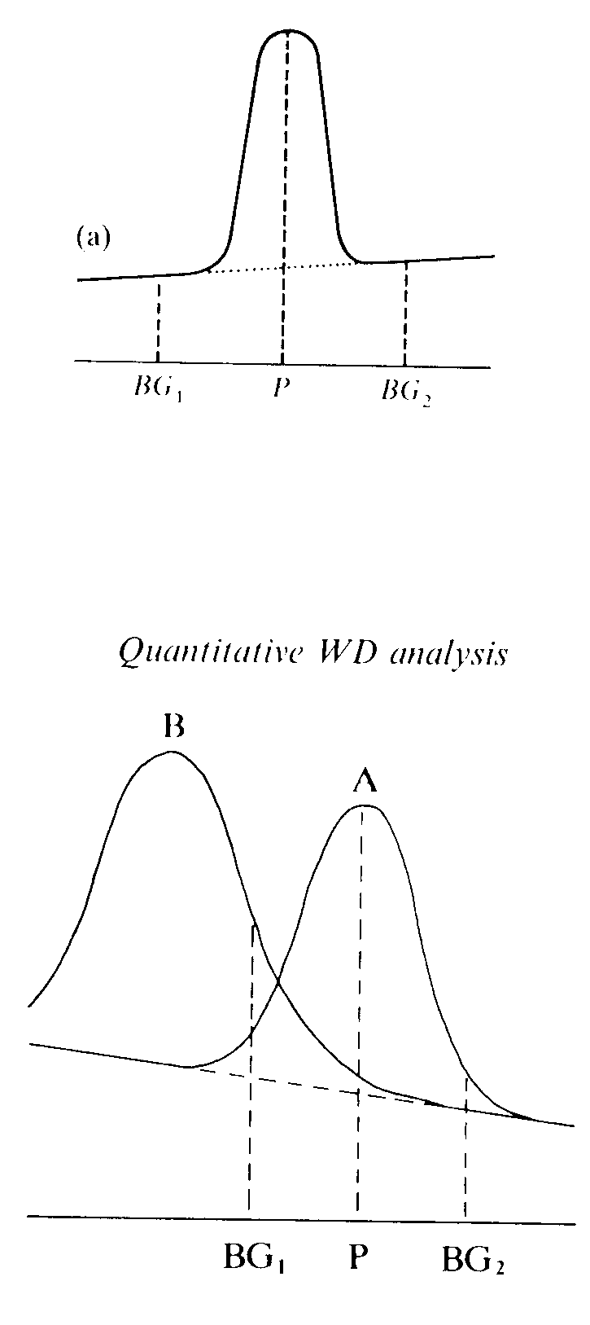

Slide 13
BKG 1

Slide 15
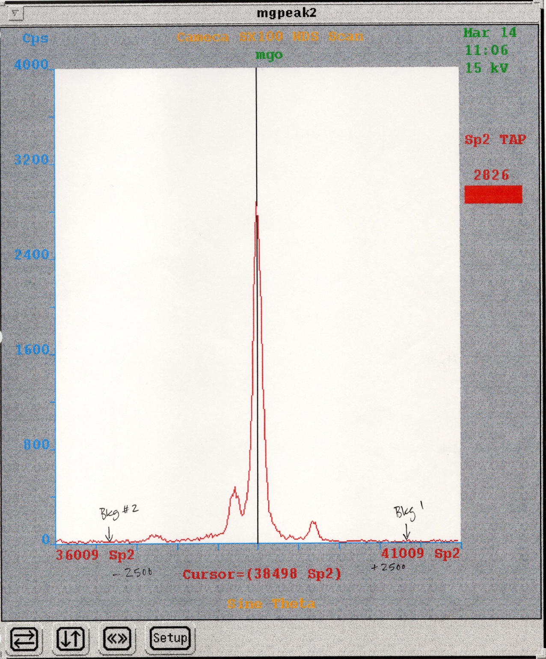

Slide 16
3. Choose suitable crystals and order of analysis.
A. Choose suitable crystals for each element
B. Minimize analysis time
C. Organize order of analysis in order to minimize spectrometer wear.

Slide 17
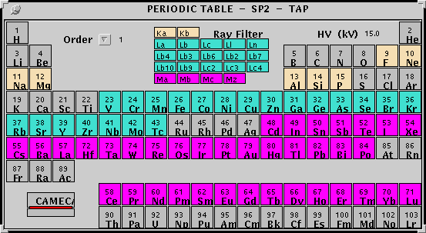

Slide 18
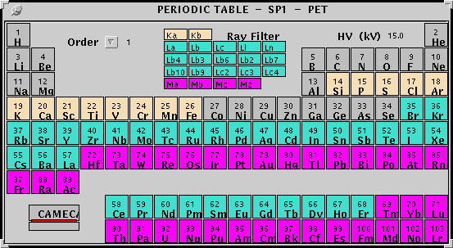

Slide 19
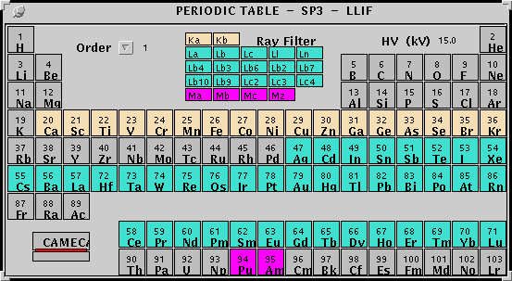

Slide 20
Matrix corrections:
Bence-Albee Alpha Coefficients
Used to be widely used for electron microprobe quantitative analysis. Has been replaced by other methods.
Empirical correction factors. Are only valid for a given accelerating voltage and X-ray take-off angle.

Slide 21
Matrix corrections
The matrix of the sample (ie. the chemical makeup of the sample) has a strong effect on the X-rays generated by any element. Must apply matrix corrections to uncorrected concentrations (K ratios) to obtain "true" compositions.
Three main controlling parameters:
Z - atomic number
A - absorption
F - fluorescence

Slide 22
Z corrections
Related to the dependence of the efficiency with which X-rays are excited on the mean atomic number of the sample.
Two distinct phenomona:
Backscattering
Electron penetration
1. Backscattering.
High-Z material produced more BSE than low Z material. So, a higher Z material will have less X-rays produced than a low Z material. This offsets, and normally outweighs, the electron penetration effect.
2. Electron penetration.
Proportionately more electrons produce X-rays when interacting with a sample of higher atomic number. So, if Z of a sample is higher than Z of a standard, the uncorrected concentration of the unknown must be corrected downwards.

Slide 23
Incident electrons lose energy by interacting with bound electrons within the sample
# of electrons per atom = Z
Atomic mass per electron = A/Z
A/Z increases with increasing Z
So:
Mass penetrated by incident electrons increases with increasing Z
------>>> X-rays intensities increase with increasing Z

Slide 24
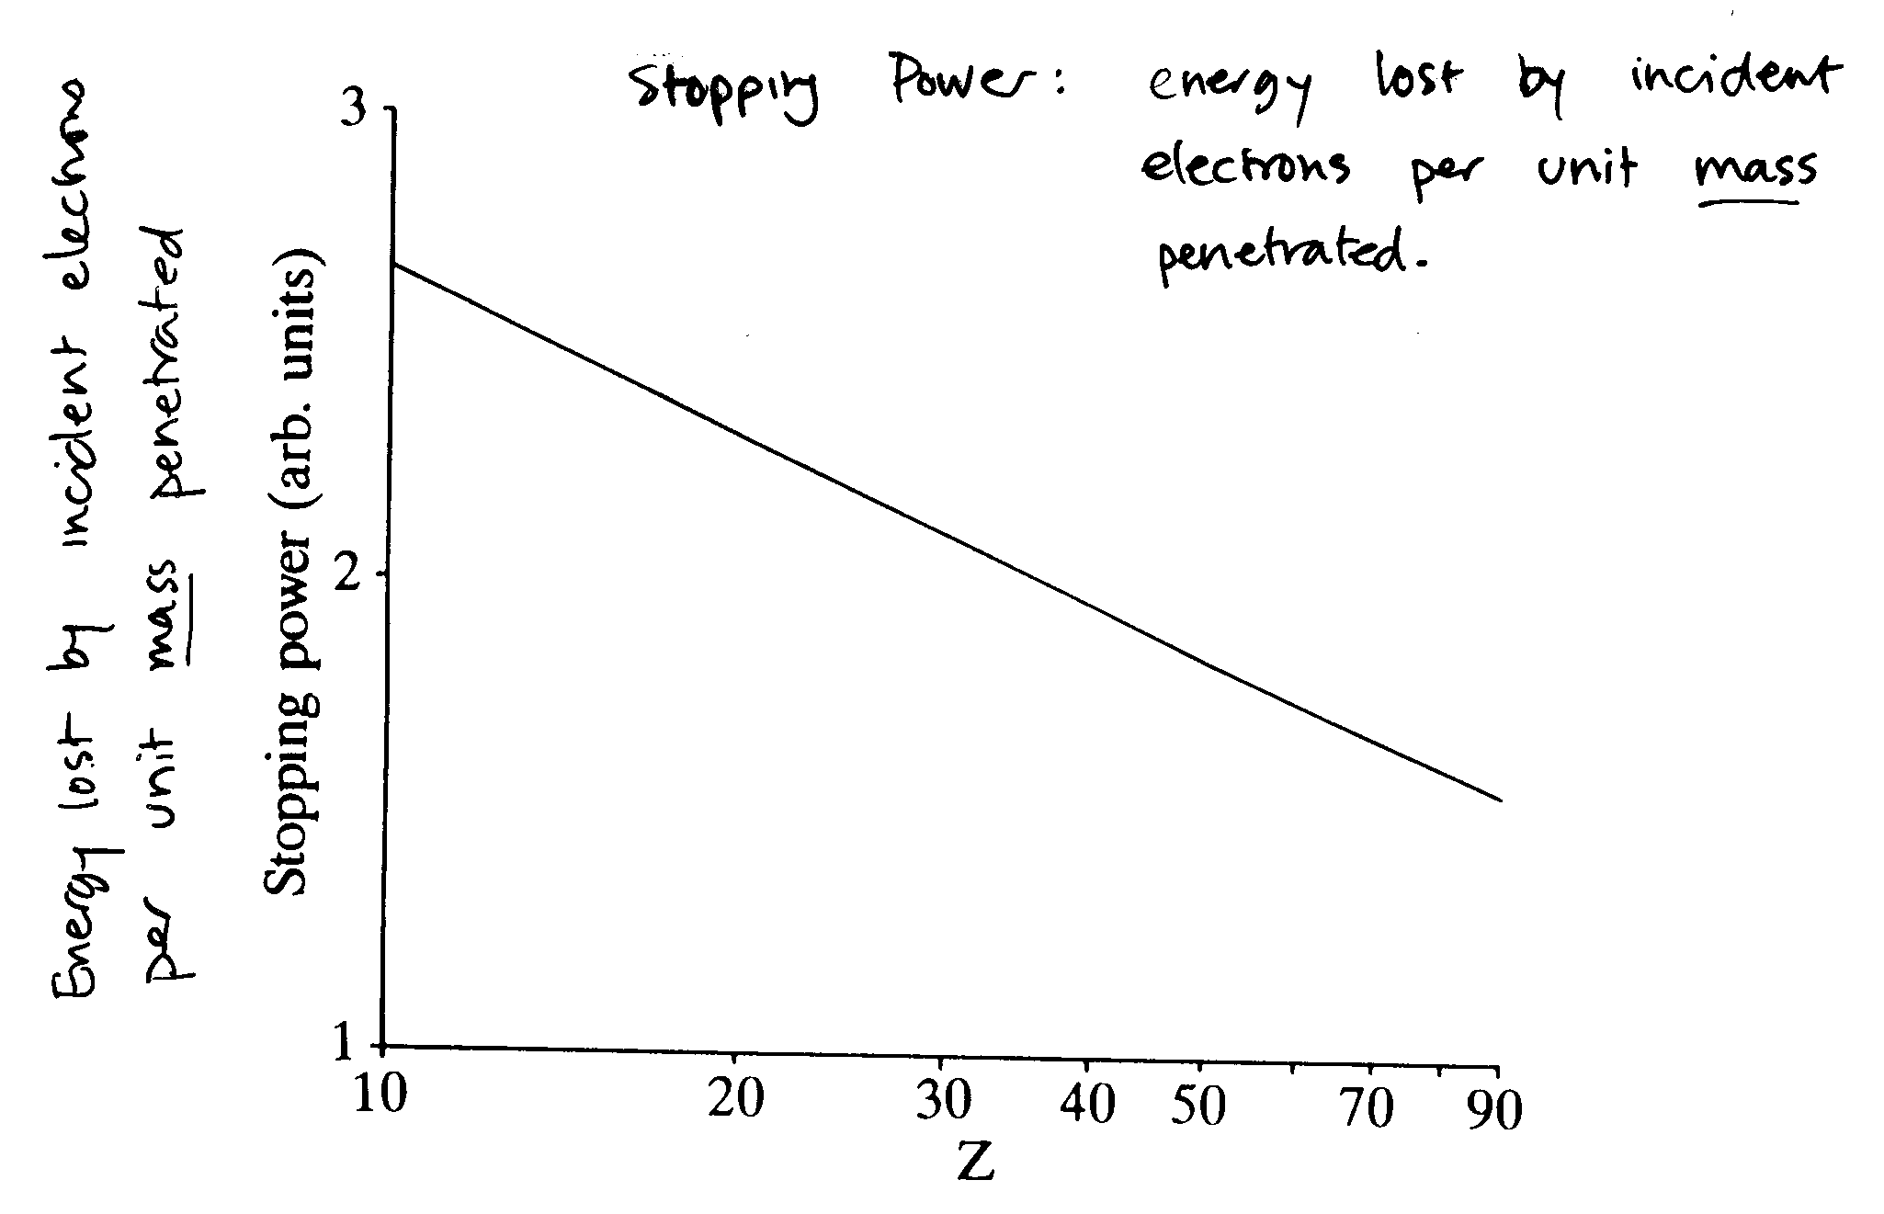

Slide 25
Absorption corrections
X-rays must travel through some amount of sample before exiting the sample surface. X-rays can be absorbed by the sample during this travel.
χ=μ cosec ψ
χ = absorption parameter (khi)
μ = mass absorption coefficient (mu)
ψ = takeoff angle (psi)

Slide 26
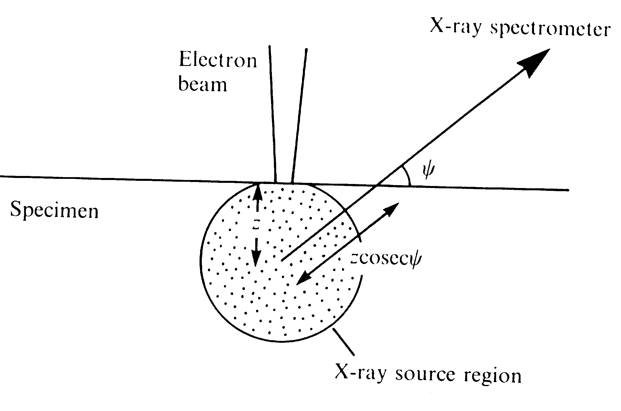

Slide 27
X-rays produced at depth Z
Intensity = I_{o}^{(- χρZ)}
Absorption parameter
μ cosec ψ
ρ = density (rho)
Z = depth

Slide 29
Fluorescence corrections
Characteristic X-rays of a given element can be excited by other X-rays when the energy of the latter exceeds the critical excitation energy of the former. Can be caused either by continuous or by characteristic X-rays.
For example, Ni Kalpha X-rays (7.48 keV) can excite Fe (critical excitation energy 7.11 keV). But, Fe Kalpha X-rays (6.4 keV) cannot excite Ni (critical excitation energy 8.33 keV).
Correction factors can be calculated. In geological samples, this correction is relatively small. The effect decreases with decreasing atomic number. More important in metallurgical samples.

Slide 30
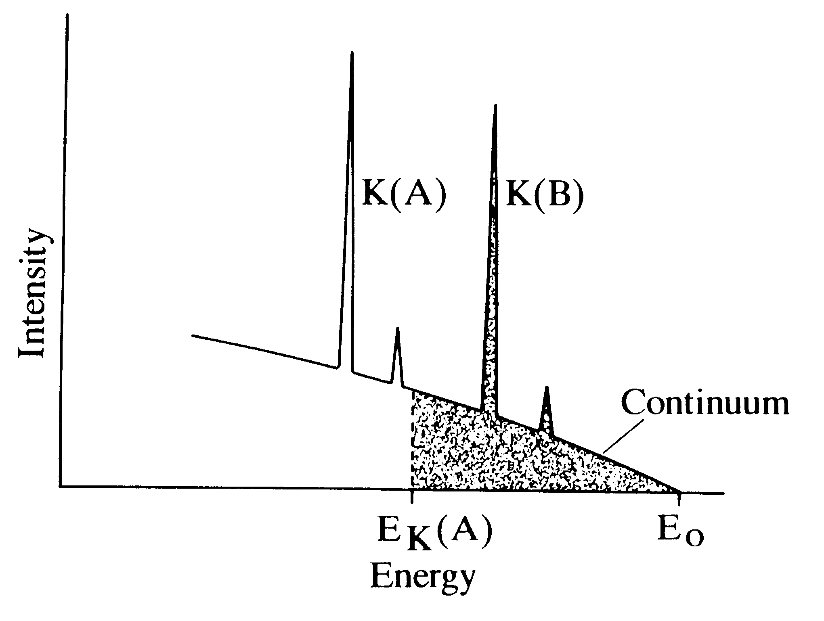

Slide 31
Correction calculations are iterative. A composition must first be assumed. Then, correction factors are calculated from that assumed composition, and a new composition is determined. Typically, three to six iterations are made. This requires COMPUTERS!

Slide 32
Unanalyzed Components
Our electron probe cannot analyze H, He, Li, Be, B, C, N, and O.
This is an issue when the unknown sample contains one or more of these elements. For example, silicate rock samples all contain a large amount of O. Some also contain H₂O. Carbonate rock samples contain C and O.
Unanalyzed components can be treated in 2 ways:
-Difference.
Assuming that the difference between the electron microprobe total and 100% is due to the unanalyzed component (s).
-Stoichiometry.
Appropriate amount of the unanalyzed component is allocated to the analyzed elements in the sample. For instance, O in a silicate rock.
Si -> SiO₂
Ti -> TiO₂
Al -> Al₂O₃
etc...
Some minerals, such as clays, contain H₂O in addition to H, and the recalculation is more difficult.
CAMECA software handles a large number of geological recalculations.

Slide 33
Choice of conditions for Quantitative analysis
-Electron acceleration
Must be higher than the excitation potential of elements to be analysed. Preferably twice this value.
Advantages of higher kV
Better analytical statistics and precision
Better peak/background, leading to better detection limits
Disadvantages of higher kV
Decreased spatial resolution
Increased absorbtion corrections
For geological samples, typically use 15 kV. Can use lower kV for light element analysis
-Beam current
High beam current yields higher X-ray intensities. But... can lead to sample damage.
For geological samples, typically use 20 nA. For glasses, use 10 or 15 nA.

Slide 34
Special cases
A. Tilted samples
If necessary, corrections can be made for analysis to tilted samples. Tilt angle must be precisely known.
B. Broad-beam analysis
Can broaden beam to determine average compositions. However, area must be <100 microns in order to not run into spectrometer defocalization. However, ZAF corrections are not accurate for a combination of phases. However, this technique can be useful for rapid, semiquantitative analysis.
C. Whole rock analysis
Fuse samples into a glass. Should not compete with conventional bulk rock analysis techniques, but can sometimes be useful.
D. Particle analysis
Small particles mounted on carbon backing can be analysed. Net X-ray intensities can be reduced relative to a flat standard, but calibrations may be done using X-ray ratios. Also, modified ZAF corrections can be made to reflect particle geometry.
E. Thin sample analysis
Spatial resolution can be increase by preparation of a very thin (100 nm) sample wafer. If sample is sufficiently thin, ZAF corrections can be neglected.

Slide 35
F. Fluid inclusions
Frozen fluid inclusions can be analyzed using a cryo-stage. Must prepare frozen standards. Must use very low beam currents (1 nA).
G. Valence determinations
Peak shifts can be observed for some elements related to valence of the element.
Fe+2/Fe+3 using L peaks
S-2/S6+ ratio in glasses by 0.003 angstrom shift in S K alpha peak.

Slide 36
