Slide 1
GEOC5089 ME5089 Exploration Geochemistry Update
INSTRUCTOR—Dr. Virginia T. McLemore
FALL 2023

Slide 2
Safety

Slide 3
Zuni Mountains study progress
summary | number
sediment | 57
ALS | 12
pan con | 2
rocks | 31
mineralized rock | 49
total | 151
Sediments to be sieved
Sediments to be dried
Sediments to be shipped
Rock samples to be shipped
One set of ALS samples shipped
2 sets shipped to USGS

Slide 4
2 batches of samples (rocks, sediments) received by USGS and are being processed
Will submit 1 more batch of sediments and 1 more batch of rocks
Areas 1 and 2
Finished sampling—private land
Areas 3-5
Examine maps and decide where else to sample
Start looking at drainages of the Proterozoic rocks
Mostly collecting sediments

Slide 5
Select sample localities for this weekend make sure you do not sample where Evan and I have sampled (check the spreadsheet)

Slide 6
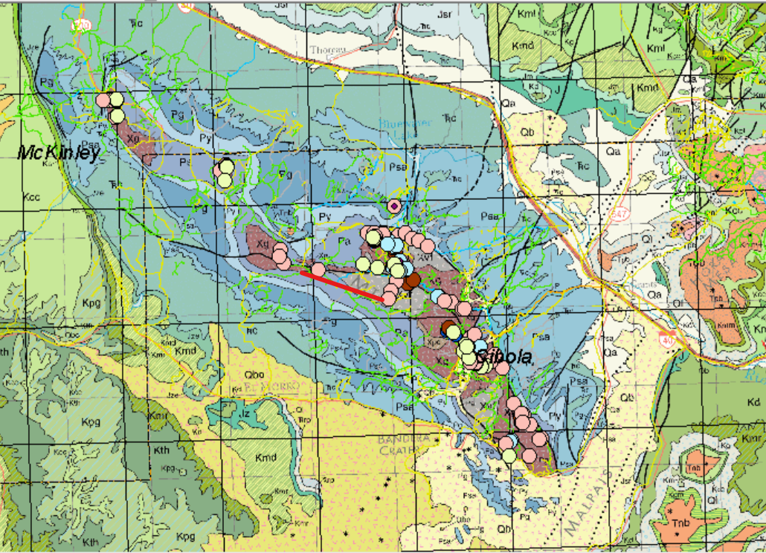

Slide 7
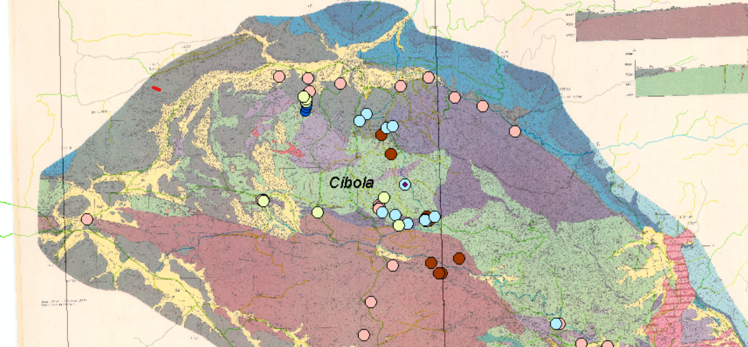

Slide 8
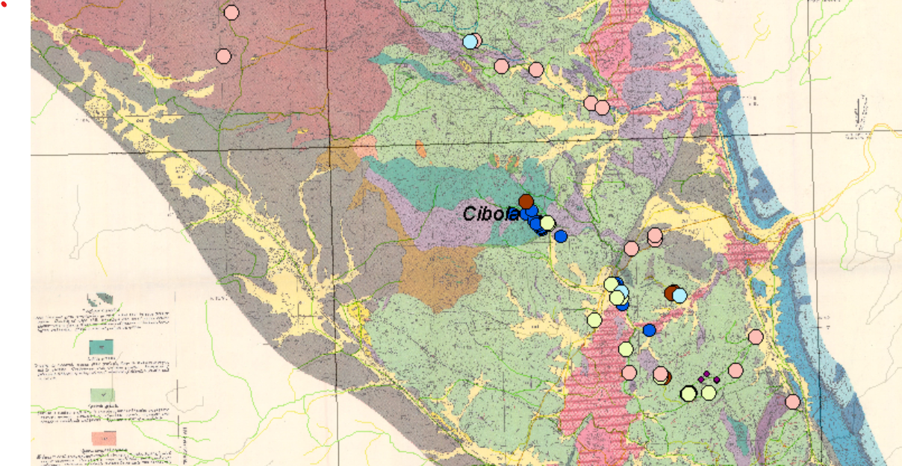

Slide 9
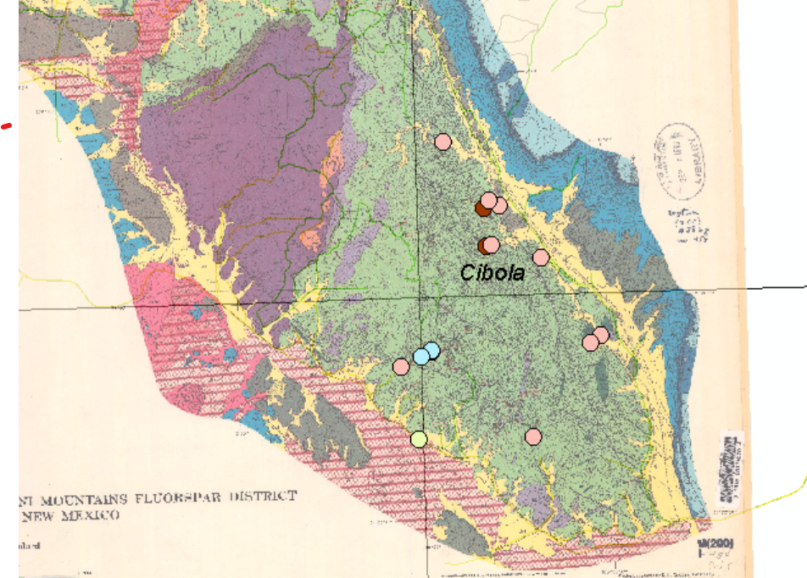
Lets get this northern area sampled for stream sediments

Slide 10
Next week Conflicts of Interest training

