Slide 1


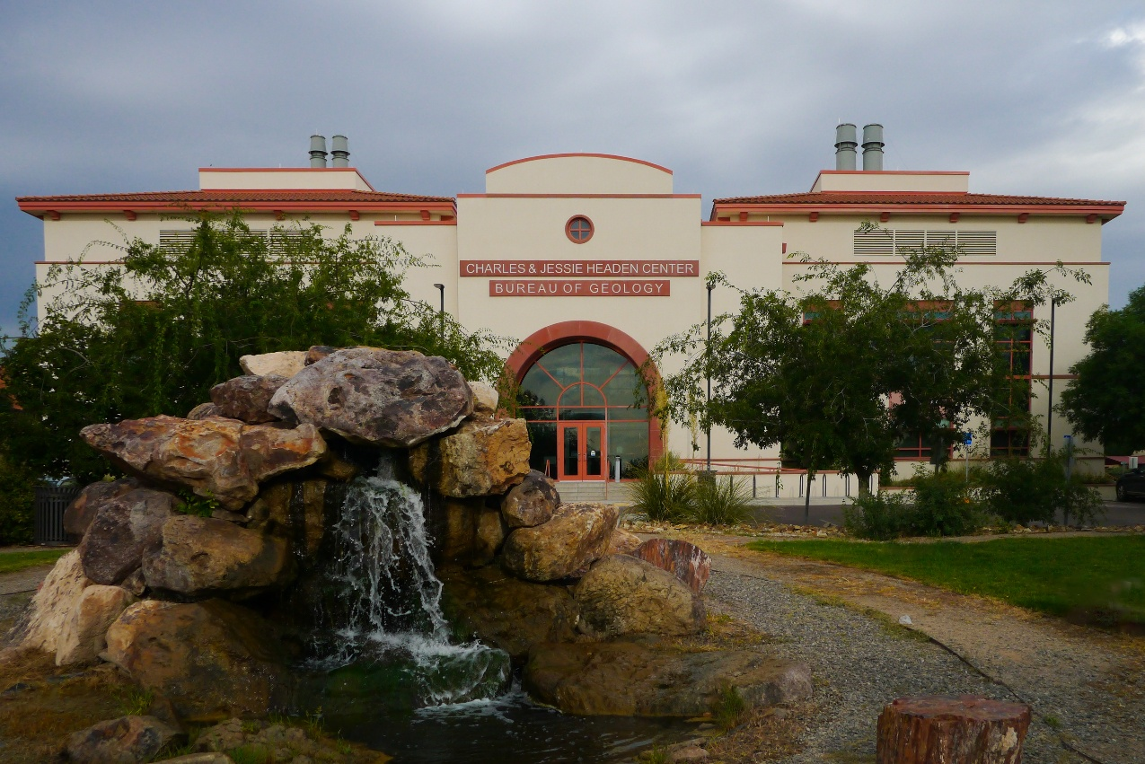



New Mexico Aquifer Characterization Update Spring 2026
Stacy Timmons
Associate Director, Hydrogeology Programs
NM Bureau of Geology and Mineral Resources

Slide 2
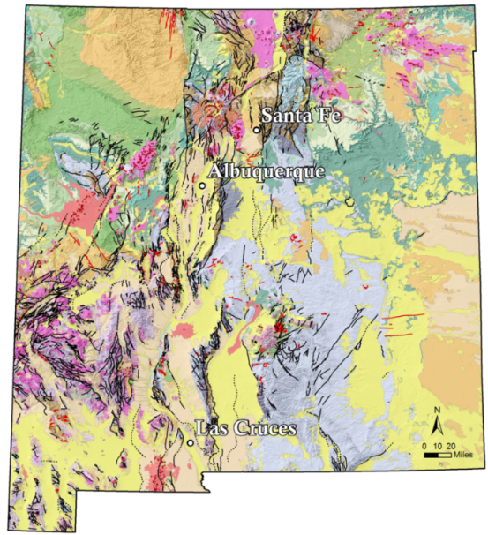


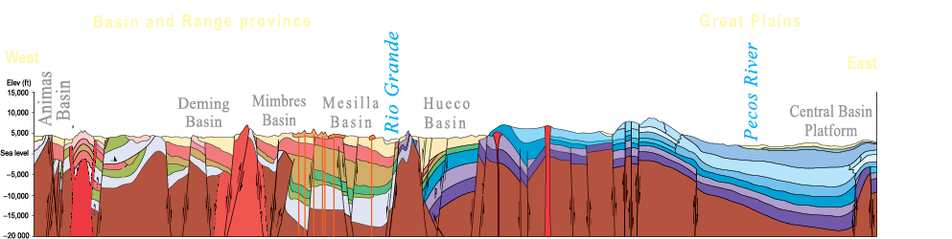
Aquifer Mapping and Monitoring Program
We are the only non-regulatory state agency engaged in this specialized, multidisciplinary water science and research
New Mexico’s geology is complex, and so are the aquifers
Many aquifers and regions have not been fully characterized
Socorro - 2022

Slide 3
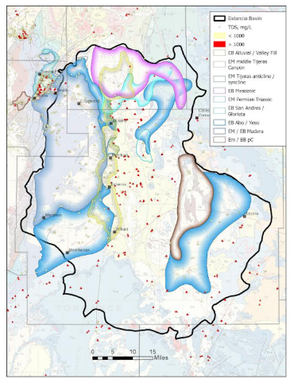
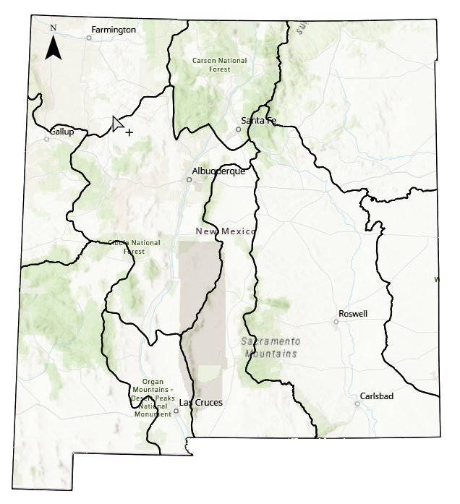
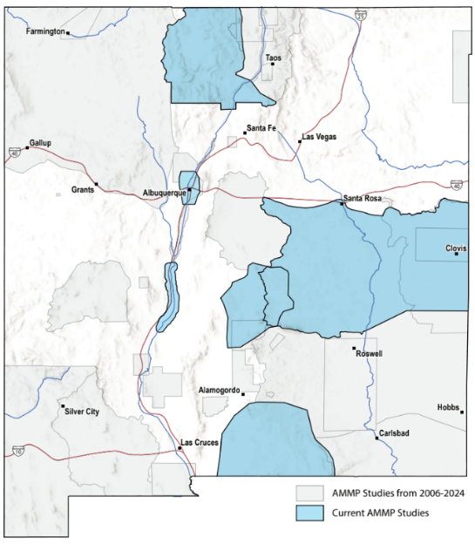

Numerous statewide and regional studies underway
Statewide Groundwater Summaries – Summer 2026
Comprehensive groundwater summaries of 10 regions
Initial funding provided by Thornburg Foundation
2D Aquifer Mapping – Fall 2026
Mapping the extent of major and minor aquifers across state
Funded by NM OSE / ISC
Regional projects
Rio Arriba County Hydrogeology – Final technical report Fall 2026
Carrizozo Regional Hydrogeology – Year 1 / 4 complete
Estancia Basin
https://geoinfo.nmt.edu/resources/water/home.html

Slide 4
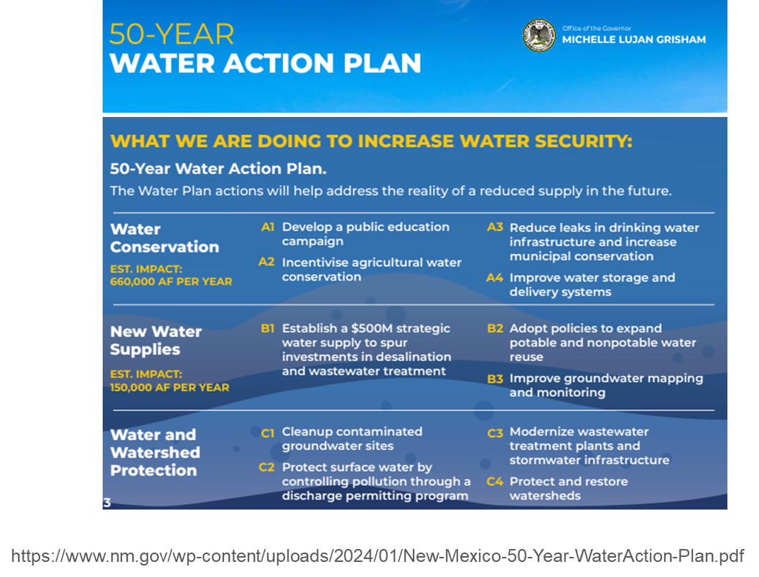

Main Goals for NM Bureau of Geology
from the 50-Year Water Action Plan
Identify and characterize major and minor aquifers within the state, including fresh and brackish sources by 2032
Establish a statewide groundwater-monitoring network with 100 dedicated wells by 2037
Multi-year funding established to date:
$2M: FY 27 Recurring budget for Aquifer Mapping and Monitoring
$7.5M: FY26 non-recurring budget (almost done!)
$22M: FY27 non-recurring budget (thank you!) ($2M of this for Water Data Initiative + grants)
Silver City - 2025
Socorro - 2022

Slide 5
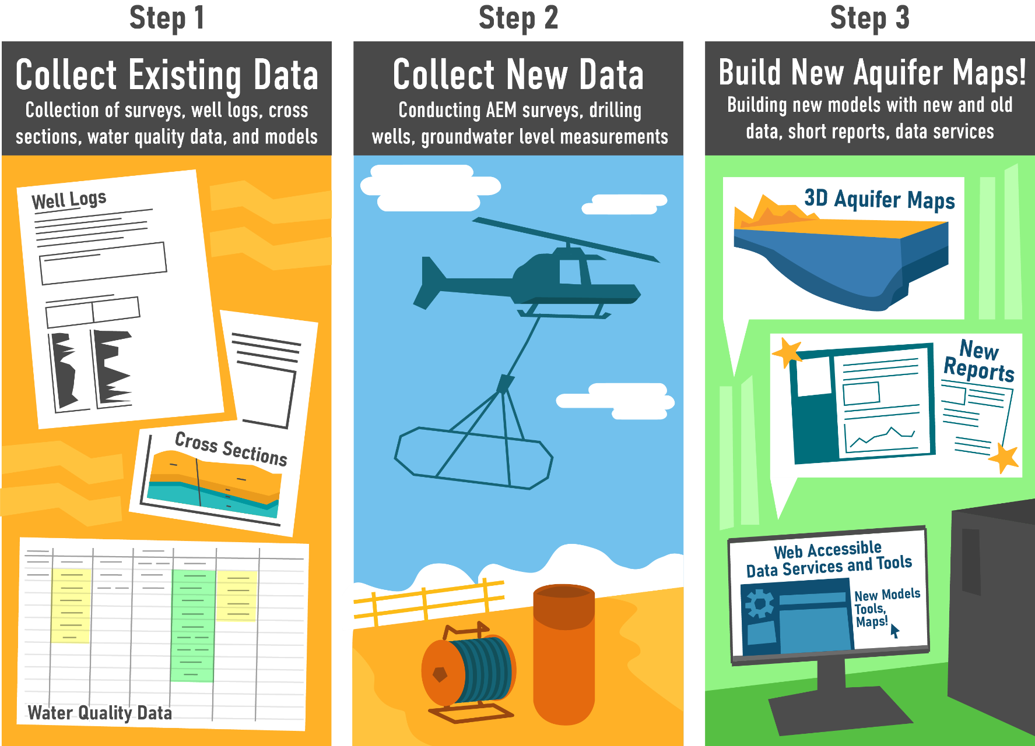
Building the solutions: Starting this Fiscal Year - 2026
Build quickly with existing data, leveraging the Water Data Act
Build teams – staff at NMBGMR and multiple contractors
Collect new data - begin to fill data gaps
Conduct large-scale hydrogeophysical surveys across New Mexico
First focus on Airborne Electromagnetic (AEM) surveys (Time-Domain EM)
Piece it together – build maps and interpretations

Slide 6
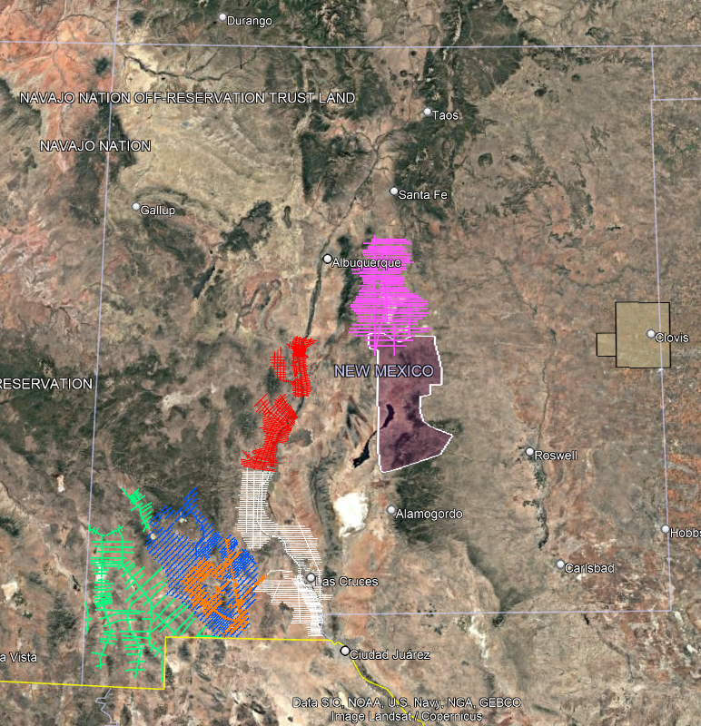
New Data Collection: FY2026
Lower Rio Grande Basins (Intera/GIP)
Fall 2025
Total Line Length: ~2500 miles
Mimbres Basin (WSP/AGF)
Fall 2025
Total Line Length: ~2000 miles
Gila–Animas Valley Region (DBSA/Geotech)
Fall 2025
Total Line Length: ~1250 miles
Estancia Basin (DBSA/Geotech)
Winter 2026
Area: ~2350 sq. miles
Total Line Length: ~1700 miles
Middle Rio Grande Basins (SSPA/Ramboll)
Winter 2026
Total Line Length: ~2000 miles
Northern Tularosa Basin – Ruidoso Slope (Geotech)
Spring 2026 (underway NOW)
Length: ~1200 miles
D
F
E
B
A
C
FY26 AEM Coverage:
Cumulative distance >13,000 miles
Estimated area >14% of NM

Slide 7
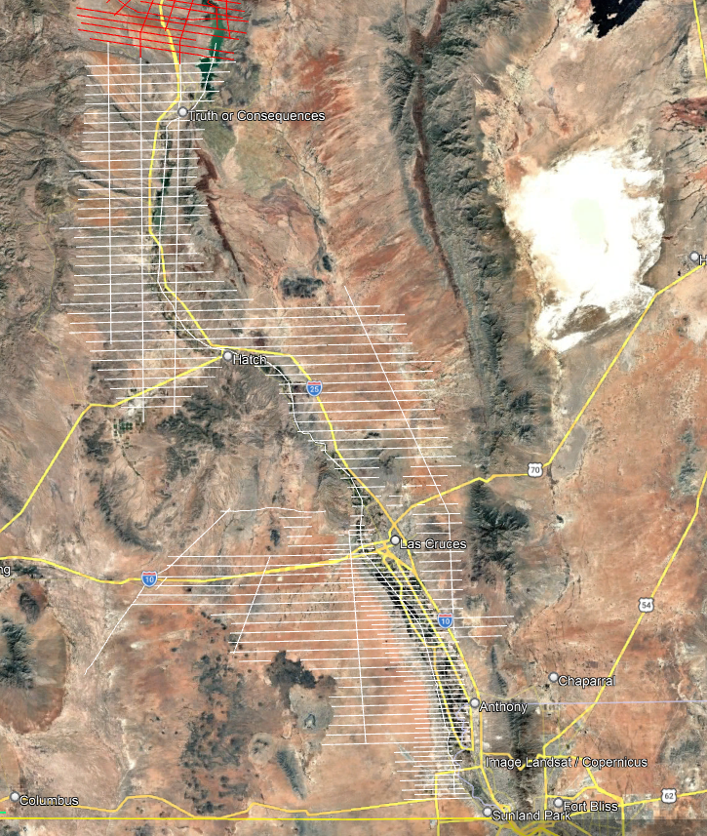

Lower Rio Grande Region 2026

Slide 8
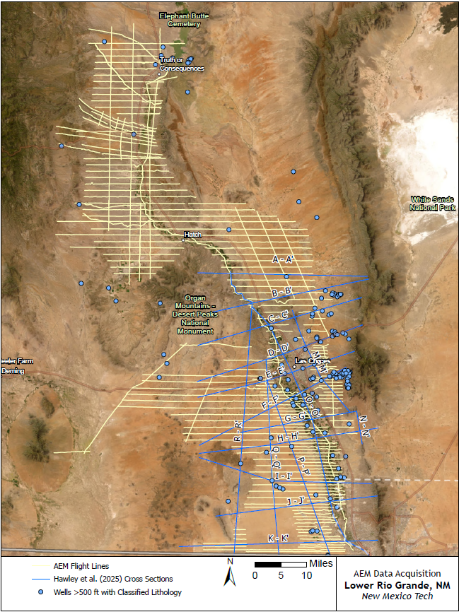

AEM Survey within the LRG
4,000 line-kilometers of data collected from November 16 – December 9, 2025
Depth of investigation for this method in the LRG is between 200 meters (656 feet) and 500 meters (1,640 feet)
Data has been processed and inverted
Project team currently working on interpretations and deliverables
Notes:
The cream lines show the flight lines along which data was collected throughout the LRG; Data was collected from Caballo Reservoir down to the international border. Aquifers within the survey area include the Palomas Jornada, and Mesilla. Cross section lines from John Hawley’s report of the Mesilla Aquifer that WRRI published last year are shown as blue lines; and the green dots show wells with a total depth of 500 ft or greater that have classified lithology data (I am sure additional wells that fit this criteria/work in progress). The AEM dataset, along with other hydrogeologic data like cross sections, borehole/well data, geologic maps, hydrothermal data, etc. are being used to improve our understanding of fresh and brackish groundwater resources within the various aquifers within the LRG and to identify data gaps where additional focused projects would aid the development of a 3D hydrogeologic framework and understanding.

Slide 9
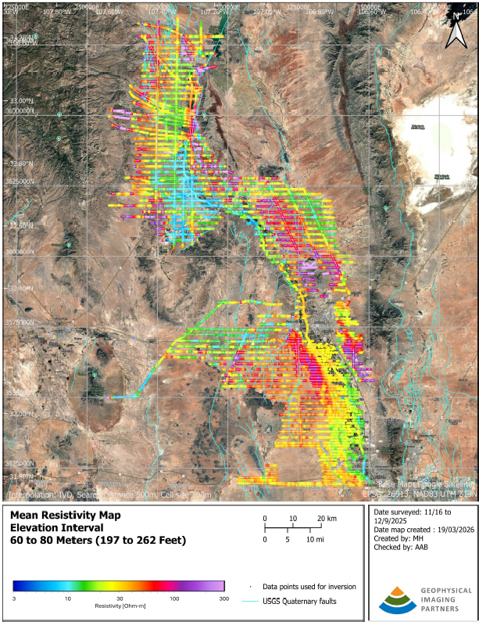
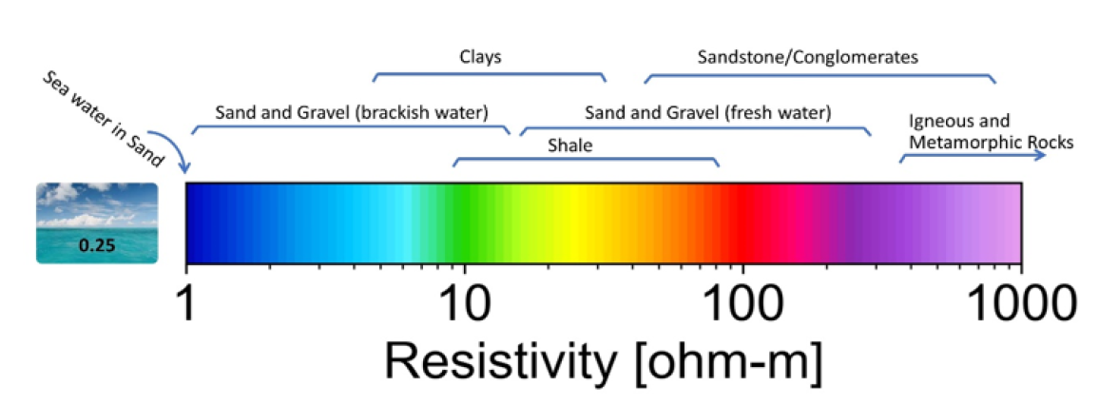
Mean Resistivity Map
Distinct regional variances in resistivity values across the survey area
Depth
Notes:
This map shows the average resistivity values along the flight lines from about 200 to 250 feet below the ground surface. Note the distinct resistivity signatures seen in the subsurface in the Palomas, Jornada, and Mesilla aquifers. Resistivity values from ~200 feet depth along the Rio Grande also show some interesting patterns. For example, resistivity values along the stretch from the outfall of Caballo Reservoir to north of Radium Springs are pretty low (blue), which is indicative of slightly brackish groundwater.

Slide 10
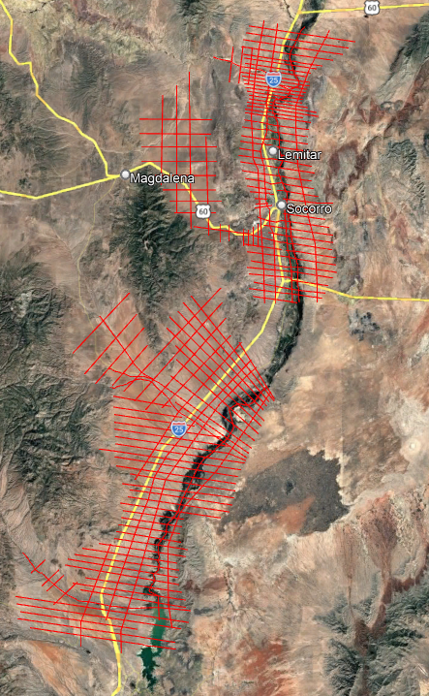
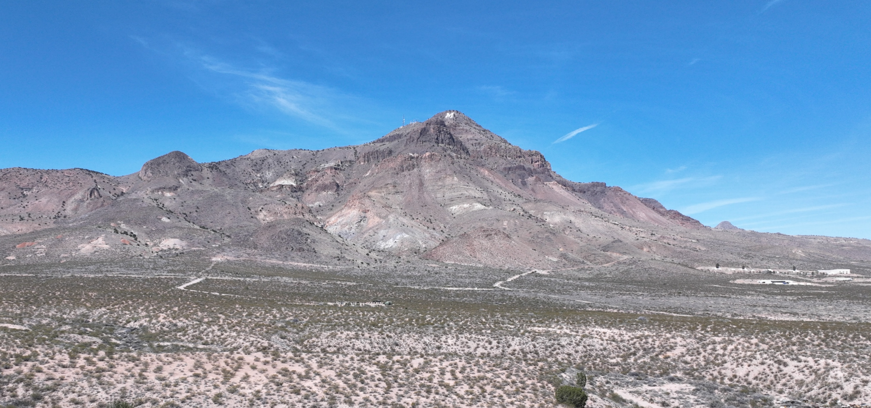




Middle Rio Grande Region
Photo: Sean Connell

Slide 11
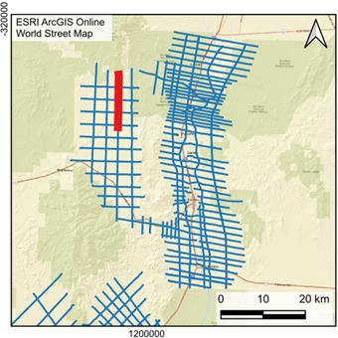
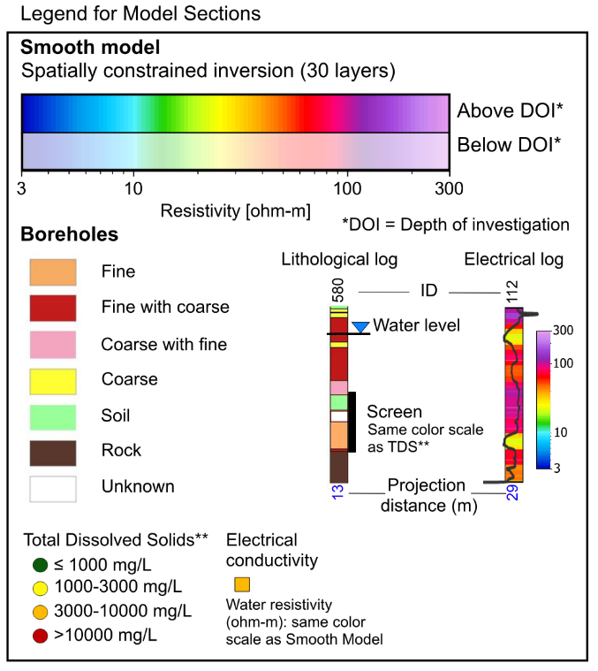
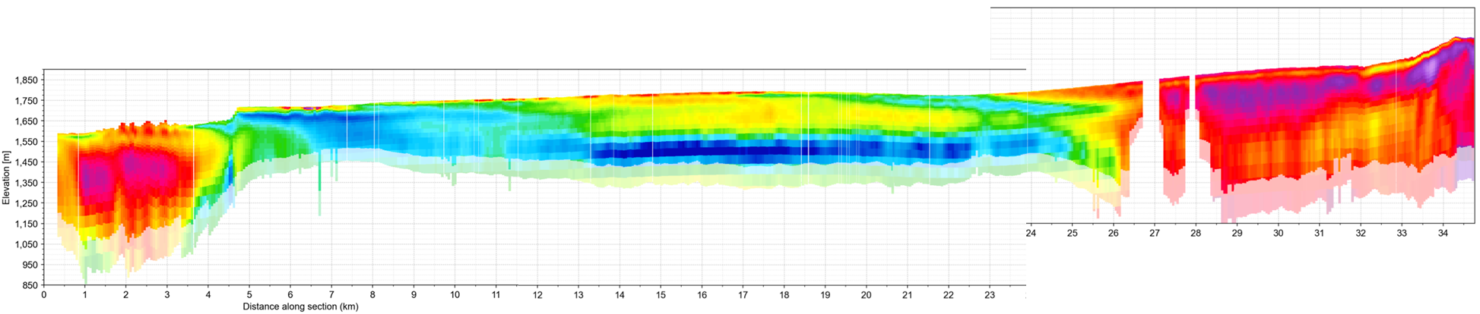

DRAFT Results Resistivity Inversions La Jencia Basin
Task 4
Products and
Recommendations
Notes:
INITIAL INTERPRETATION, BY SSP&A (SUBJECT TO REVISION: RAMBOLL/SSP&A WILL PROVIDE OFFICIAL INTERPRETATION):
North (left) to South (right) 35 km flightline in the La Jencia Sub Basin
km 1 - 3 and from 26 to 35: very high resistivity (red), probably volcanics or potentially uplifted pre-Santa Fe basement
Around km 4, and also around 25: faulted transitions entering and leaving sedimentary basin, respectively
km 4 - 25: sedimentary basin
Thin resistive cap (red/yellow) across much of the basin, potentially Upper Santa Fe group (Sierra Ladrones)
Broad, persistent low resistivity band (blue), either fine grained, clay rich Middle Santa Fe group (Popotosa Confining), or saline at depth

Slide 12
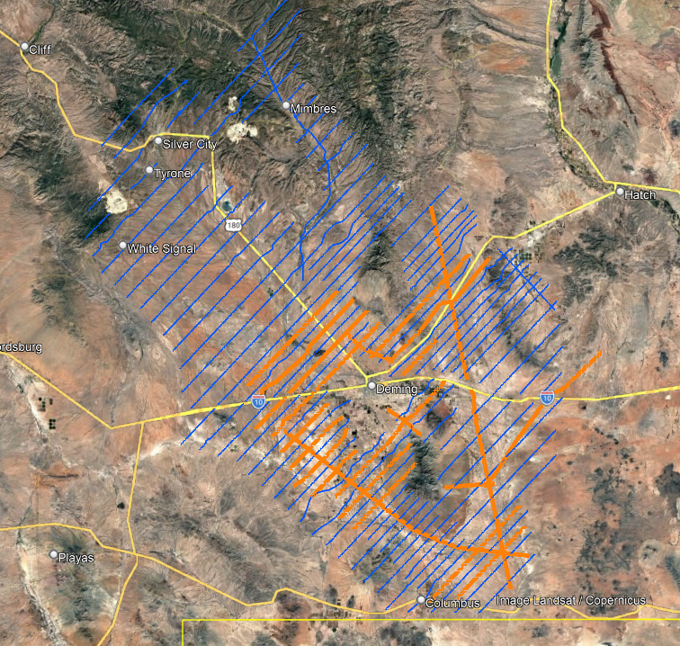



Work in the Mimbres Basin

Slide 13
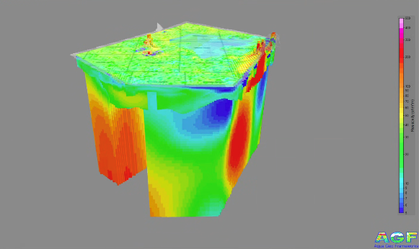
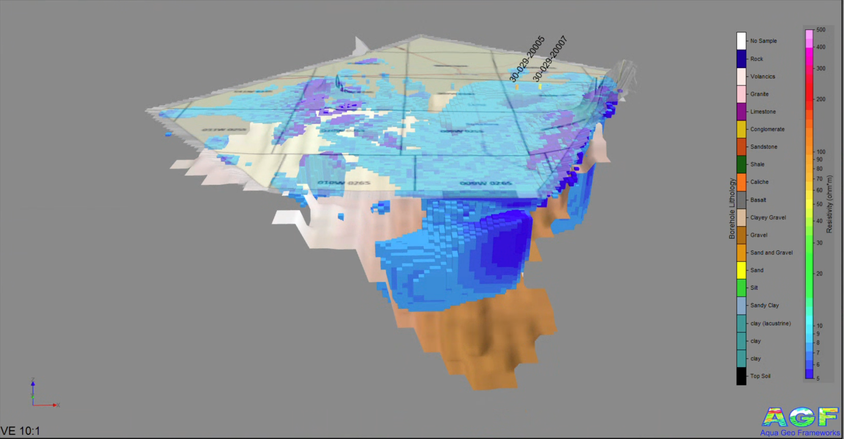
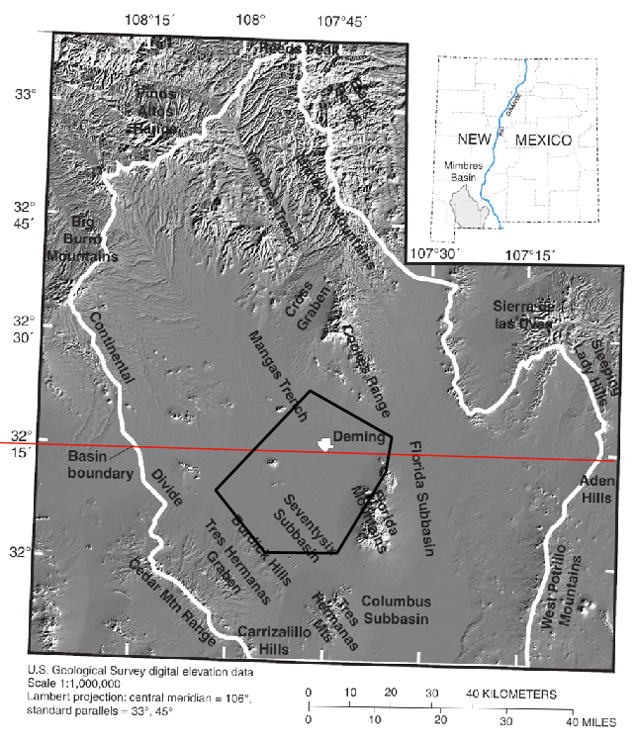
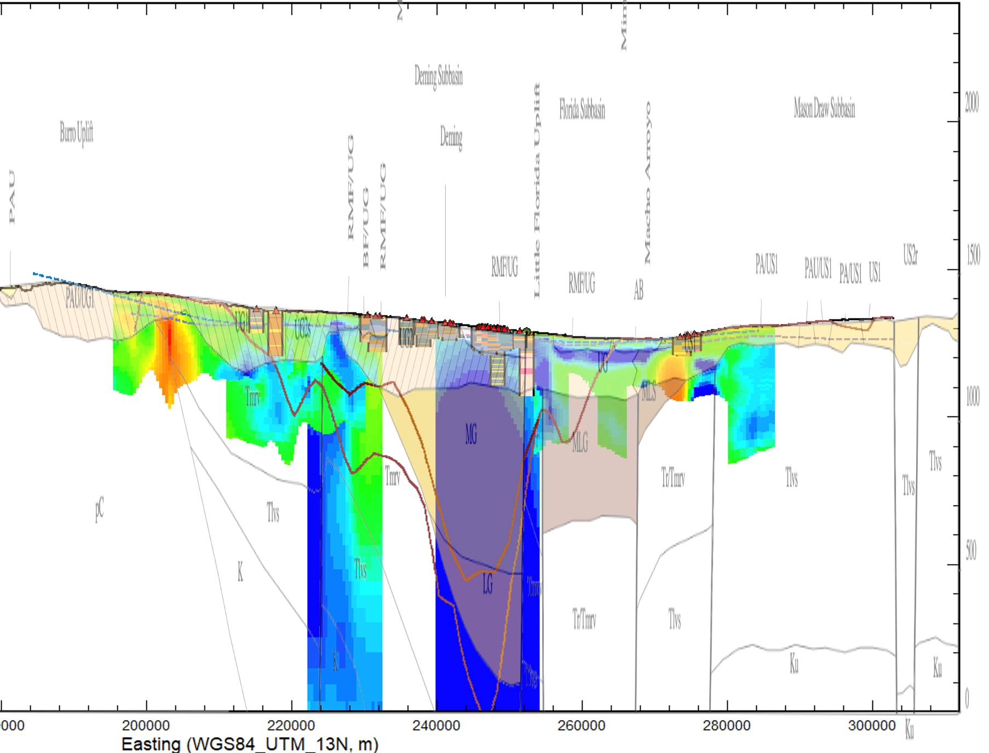
Full AEM and MT resistivity model
Threshold of the AEM and MT Resistivity < 8 ohm-m
Near-surface clay layers
City of Deming
O&G Wells
Geology cross section
1,300 meters ( ~ 4,260 Feet)
Passive seismic, refraction seismic,
gravity, and borehole bedrock surface
North
Thicker deeper clay layers and possible brackish waters
Geology cross section
43 km ( ~ 26,7 miles)
Geology cross section
Heywood, et. al, 2002, WRIR02-4007
Thicker deeper clay layers
and possible brackish waters
Example from Deming area
Hawley et al., 2000, Trans-International Boundary Aquifers in Southwestern New Mexico
Notes:
The area of the City of Deming was unflyable by the Airborne Electromagnetics (AEM). Magnetotellurics (MT) and Passive Seismic was used to add as much control as possible, however data gaps exist within the city.
Additional data was used for interpretation.
-Refraction Seismic (Ackermann et al., 1994)
-Gravity (Heywood et al., 2002)
-Oil and Gas Boreholes (TGS, 2025)
-Geological cross sections (Hawley et al., 2000)
We observe near surface clay layers over much of the area within the upper aquifer system that are confirmed by water wells. Below the upper aquifer units thicker lacustrine clay exist. The thick clay is where many of the local water wells stop. Below the clay Oil and Gas wells indicate some coarse materials. Some of these materials have a low resistivity and may indicate brackish waters. Further drilling would need to be conducted to verify the water quality.
Images:
Full AEM and MT resistivity model - all the data from the AEM and MT
Threshold of the AEM and MT Resistivity model < 8 ohm-m – only the areas of the model < 8 ohm-m are shown
Geology Cross section – from Hawley et al., 2000 C-C’ and the AEM and MT resistivity along that transect. Estimated bedrock from Gravity and the Passive Seismic are indicated as lines boreholes along transect are also indicated.

Slide 14
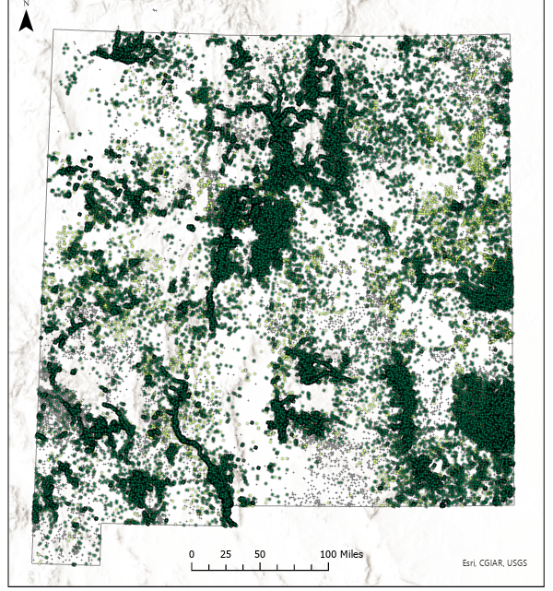
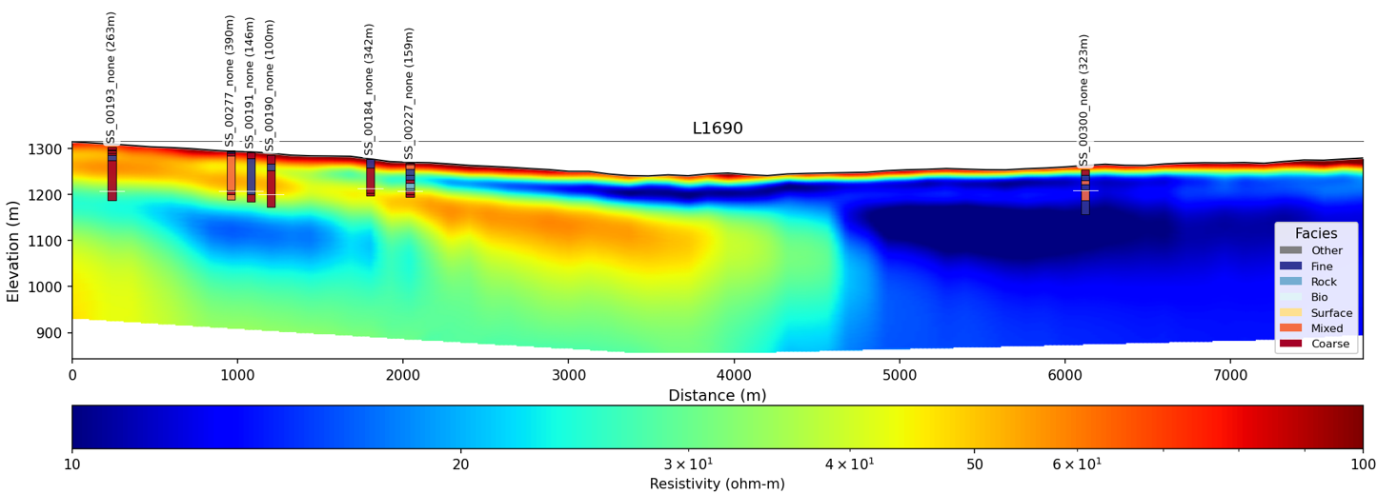
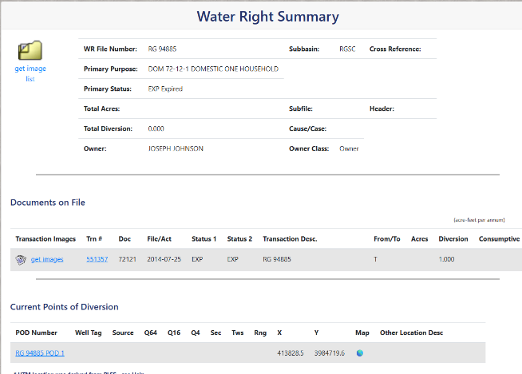
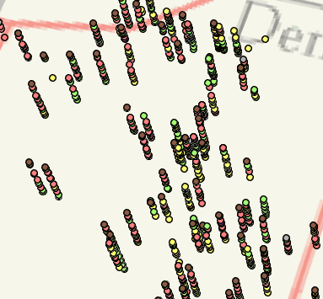
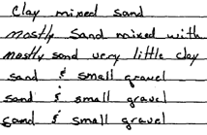
Work underway: Calibration with well data
Scrape the Office of State Engineer’s Water Rights Reporting System for pdf logs
Run text recognition on the pdfs (OCR)
Turn the text into classified lithology (e.g., sand, gravel, clay) and texture (e.g., coarse, fine)
Analysis and QA
Scrape logs
Recognize text
Classify/Lump
Analyze
Silver City - 2025
Socorro - 2022
Rock
Fine
Mixed
Coarse
Clay
Sand
Gravel
Silt
Sand & Clay
Sand & Gravel

Slide 15
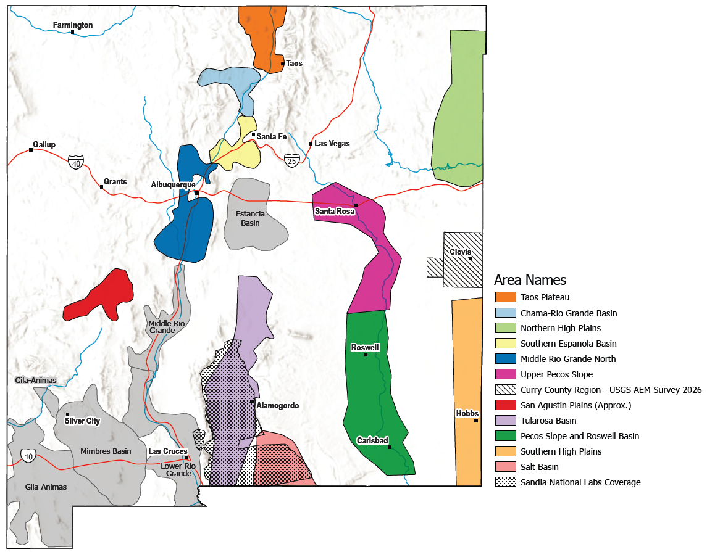


A multi-year project: Looking ahead to next year
Building interpretations and conceptual hydrogeologic models with consulting teams
Explore alternative methods for data collection
Developing data sharing platforms
Determining locations for well drilling and developing well designs

Slide 16
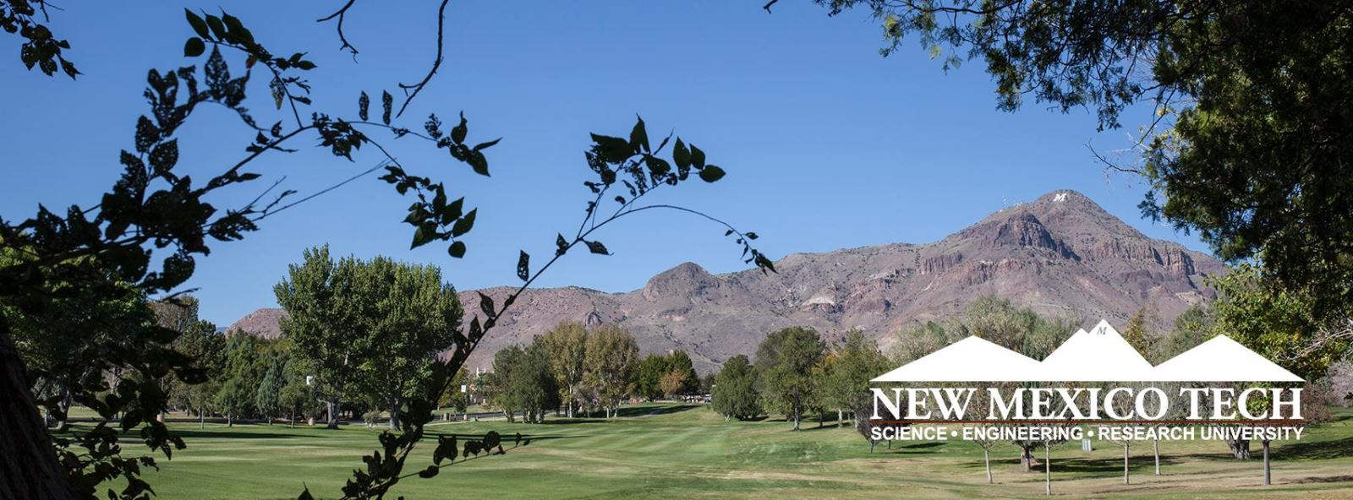
Thank You for helping us do this important work for New Mexico
Water Programs FY2028 anticipated requests
Target for Aquifer Mapping and Monitoring: $0!
Non-recurring Target: $22M in FY28 for aquifer characterization and Water Data Programs
Continue progress on data collection and interpretation/ model development
Drilling exploration and monitoring wells
$2M for Water Data Program (agency / academic grants)
Stacy Timmons: stacy.timmons@nmt.edu
https://geoinfo.nmt.edu/resources/water/amp/home.html

