Slide 1
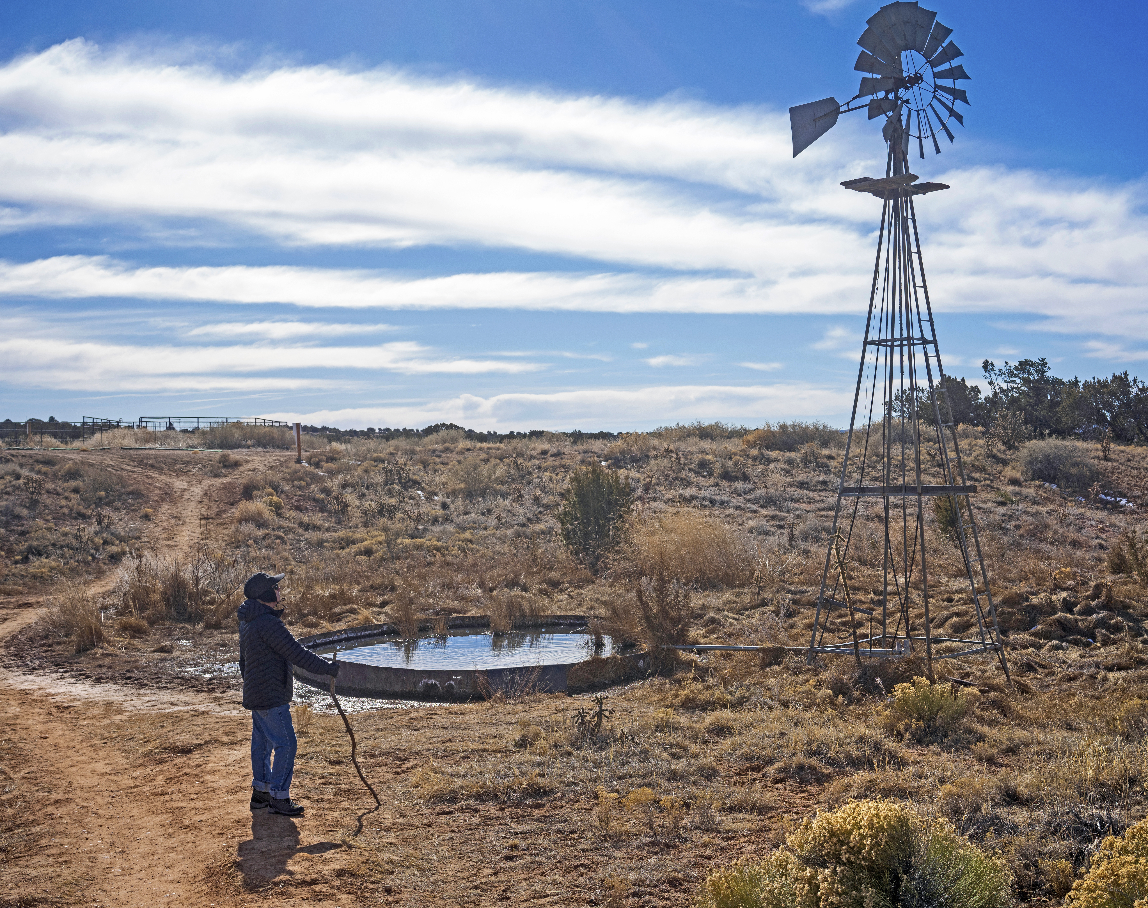
Road Towards
New Mexico's Groundwater Security
Gretel Follingstad, PhD
Senior Manager, Climate Resilient Water Systems
Environmental Defense Fund
Notes:
EDF is a global NGO - build a vital Earth for everyone - Finding practical Solutions to Natural Resource Problems
Environmental NGO – I grew up in Santa Fe, NM
water work in NM: “Building the multiple needs of people and nature into the everyday business of managing water.”
Introduce Gretel as key NM EDF staff with generational roots in NM. Members will likely be hearing more about this issue from Gretel in the future.
Reference and link comments to the Rural Infrastructure Needs Study, 2021 (the driver in the creation of the ERDPCC in 2023) - highlight elements in the report that echo the reason for this presentation.
Clean drinking water depends on built infrastructure BUT also natural infrastructure such as aquifers.
Just as we need to understand and manage built infrastructure, we need to understand and manage natural infrastructure – both need strong science and public policies, both need public investments upfront and ongoing.

Slide 2
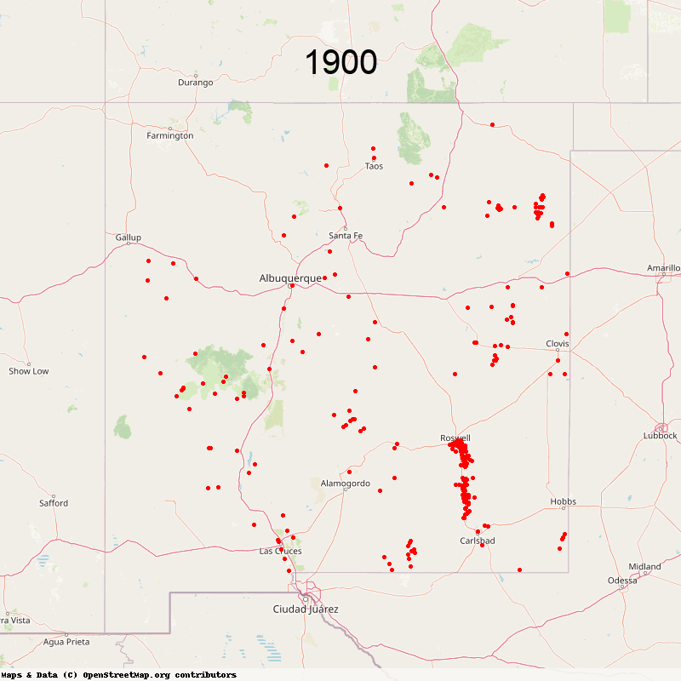
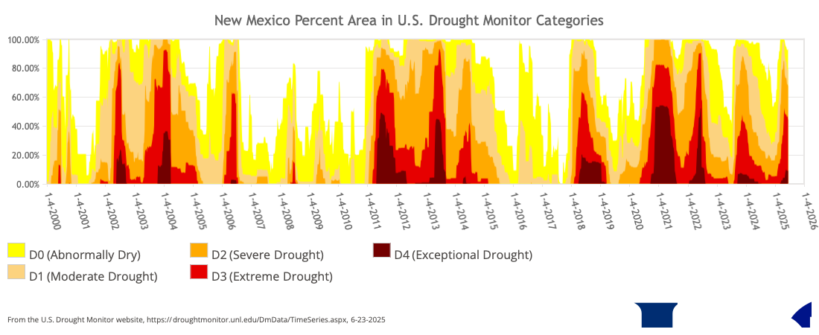
NM’s Ongoing & Future Challenges
  Climate Change impacts
  Multi-decadal scale drought,
  Water Quality: Arsenic, Uranium, localized run-off & PFAS, etc.
  New Large Water Demands (Data Centers etc.)
Groundwater Wells – 1940s-2020
Source: mainstreamnm.org
Notes:
Groundwater declines reaching crisis levels
High Plains (Ogallala), Mimbres, Albuquerque, Estancia, etc.
Threatening agriculture and rural communities
Significant gaps in groundwater knowledge
Need for groundwater mapping, monitoring & metering
Ongoing & future challenges
Climate change, drought, PFAS, etc.
Basin Specific, Locally-driven Groundwater Management needed now
Need proactive groundwater management for aquifer longevity
Lessons learned from other states & tools/approaches for New Mexico

Slide 3
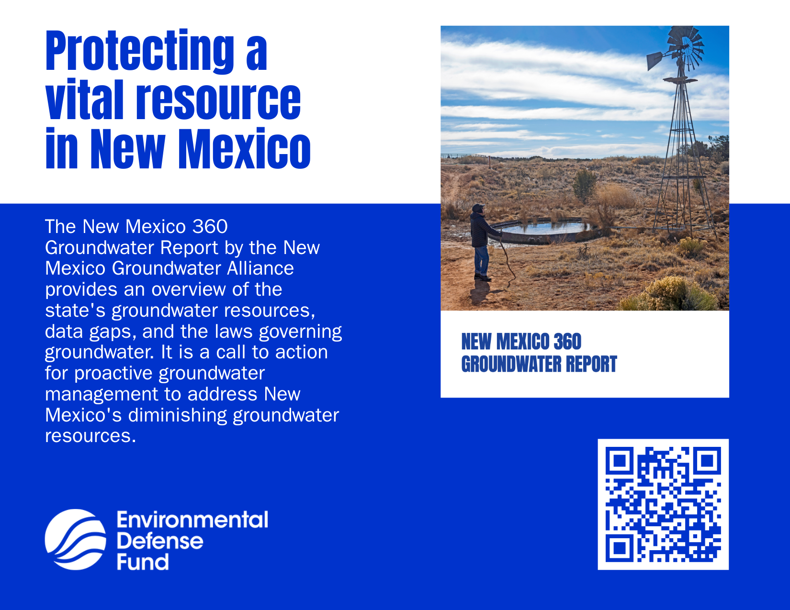
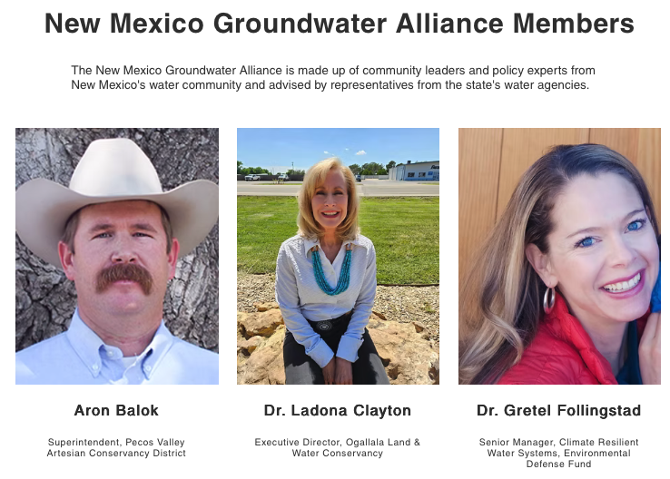
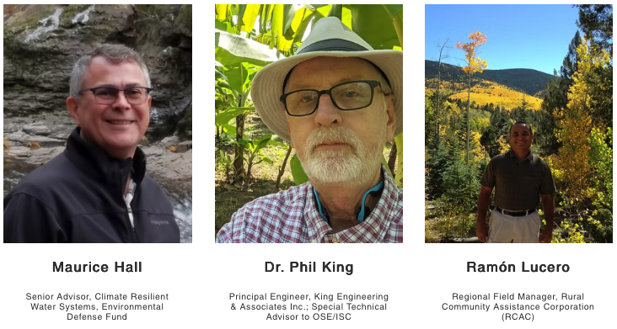
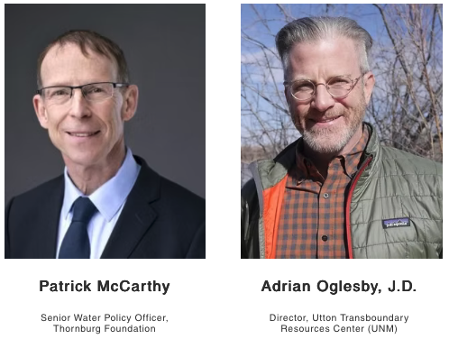
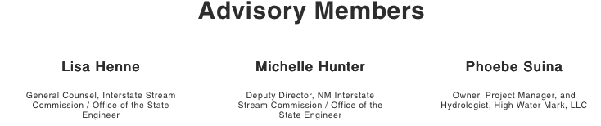

New Mexico Groundwater Alliance
Subset of experts from the Governor’s Water Policy Task Force
Notes:
EDF helped convene the Groundwater Alliance beginning in 2023 to respond to the Water Policy and Infrastructure Task Force Report – and need for proactive GW Mgt.
Many regions are observing declining water levels due to ongoing use of groundwater and slow recharge from drought conditions. Well drilling technology was nearly non-existent until the late 1940’s, but since that time roughly 2,000 wells have been drilled each year.

Slide 4
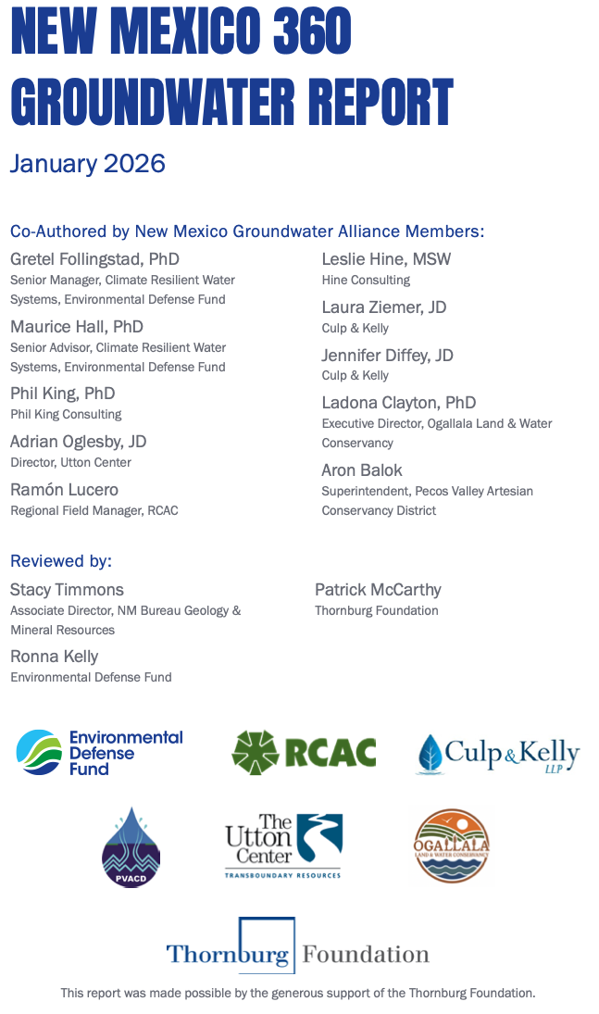
Building Groundwater Solutions for New Mexico
New Mexico 360 Groundwater Report (2026)
Co-authored by the NM Groundwater Alliance Members
Released January 2026
Report provide details on NM’s groundwater & governance:
                New Mexico’s groundwater use
                Current aquifer conditions (where known)
                Data gaps
                Recommendations
Notes:
EDF helped convene the Groundwater Alliance beginning in 2023 to respond to the Water Policy and Infrastructure Task Force Report – and need for proactive GW Mgt.
Many regions are observing declining water levels due to ongoing use of groundwater and slow recharge from drought conditions. Well drilling technology was nearly non-existent until the late 1940’s, but since that time roughly 2,000 wells have been drilled each year.

Slide 5
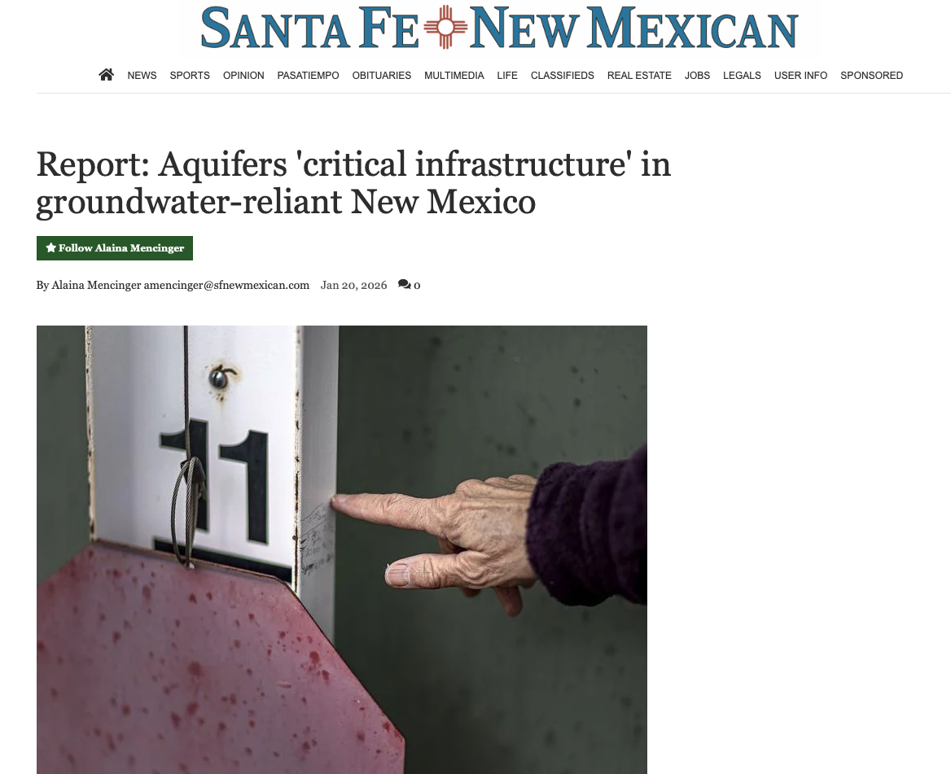
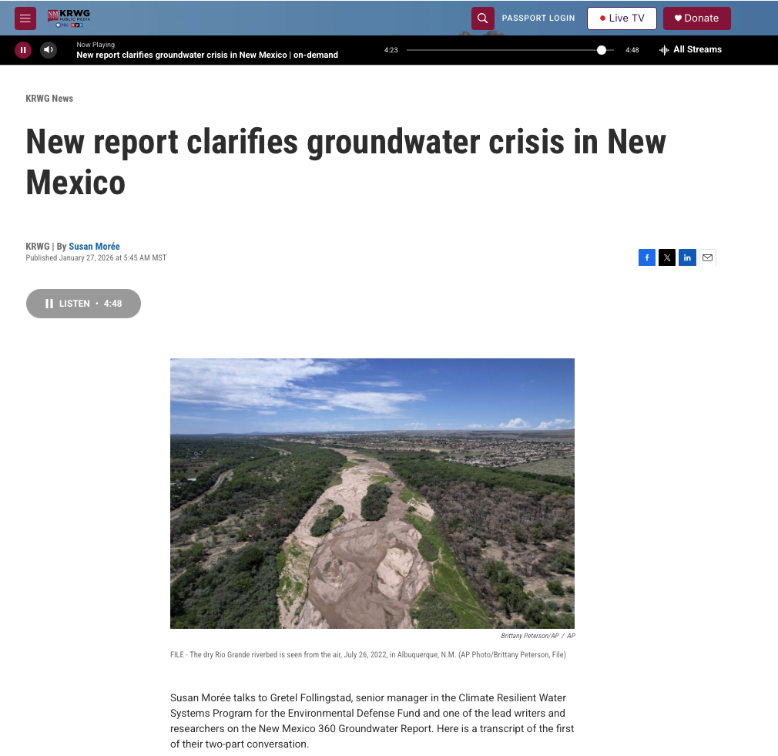
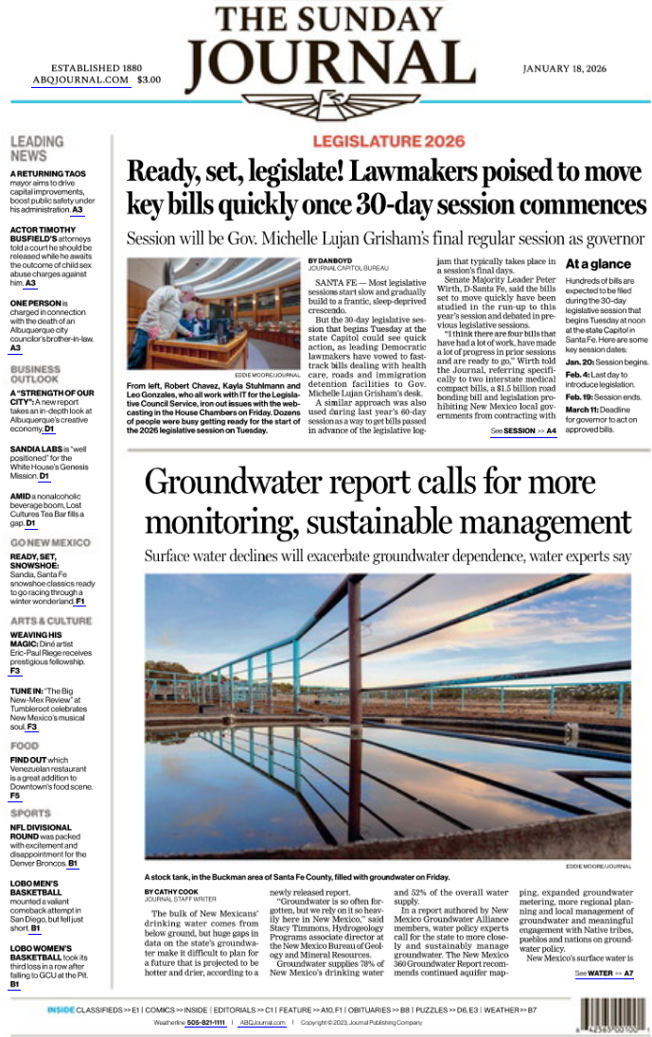
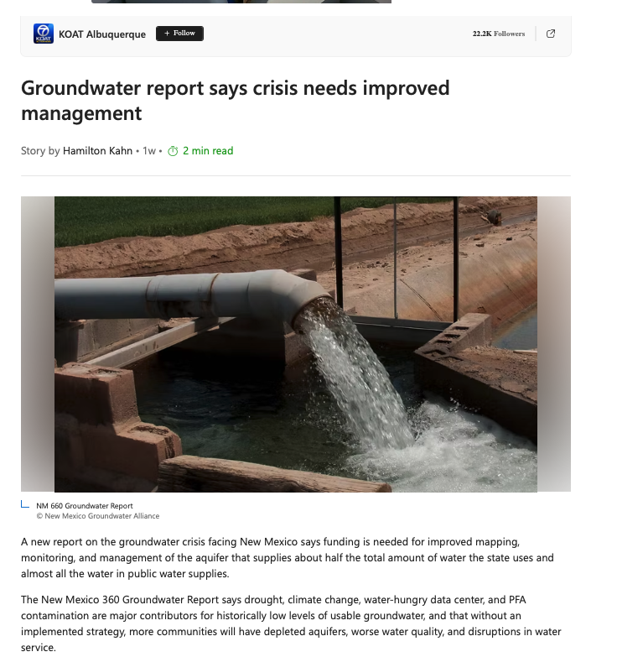
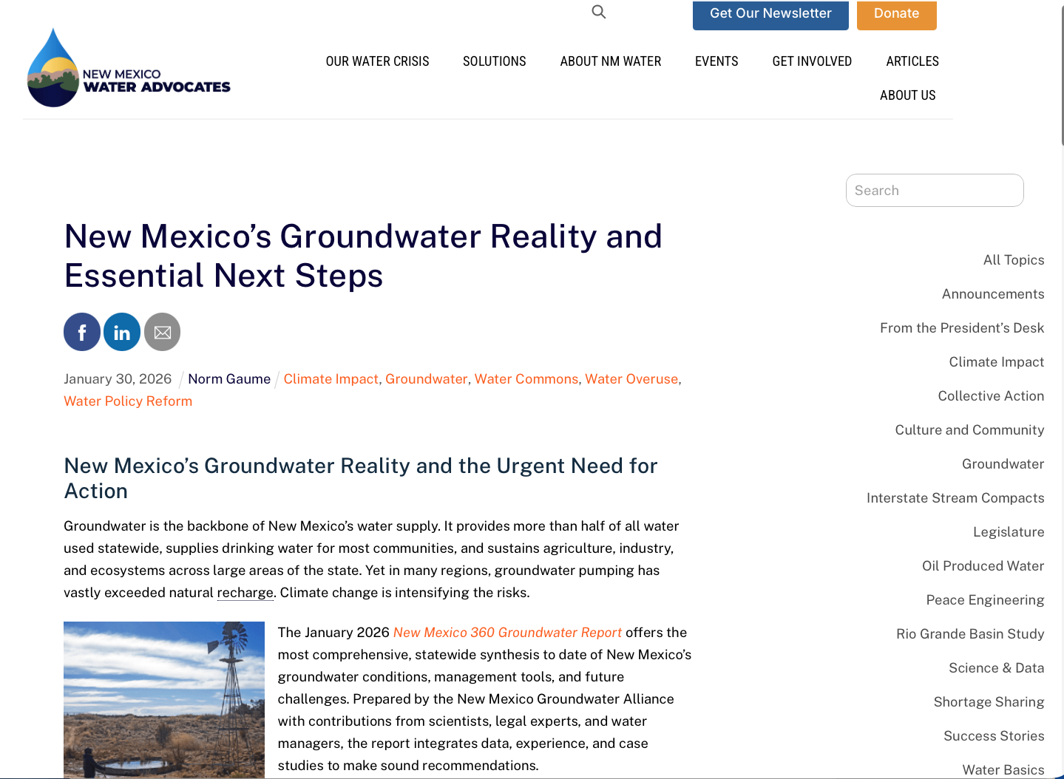

Slide 6
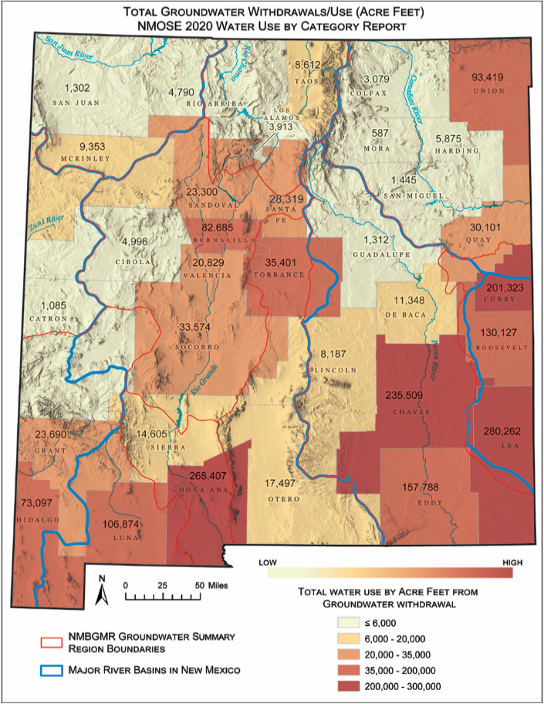
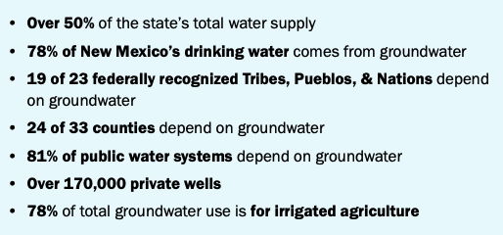
NM 360 Groundwater Report: By the Numbers
6
Notes:
This critically essential water source supplies New Mexico’s 19 Pueblos and 23 federally recognized tribes, 24 of 33 New Mexican counties, together comprising 78% of the state’s population. Importantly, 81% of New Mexicans are served by public systems that rely on ground water sources and over 170,000 New Mexicans depend on private wells for drinking water. Groundwater also supplies 50% of the water used for irrigated agriculture. Other key sectors reliant on groundwater across the state include commercial business, industrial and energy uses.

Slide 7
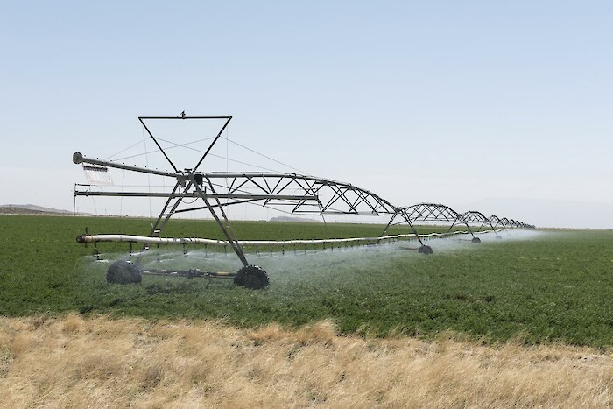
NM 360 Groundwater Report: By the Numbers
Groundwater declines reaching crisis levels in some areas
  High Plains (Ogallala), Mimbres, Albuquerque, Estancia, etc.
  Threatening agriculture and rural communities’ drinking water supply
Notes:
Groundwater declines reaching crisis levels
High Plains (Ogallala), Mimbres, Albuquerque, Estancia, etc.
Threatening agriculture and rural communities
Significant gaps in groundwater knowledge
Need for groundwater mapping, monitoring & metering
Ongoing & future challenges
Climate change, drought, PFAS, etc.
Basin Specific, Locally-driven Groundwater Management needed now
Need proactive groundwater management for aquifer longevity
Lessons learned from other states & tools/approaches for New Mexico

Slide 8
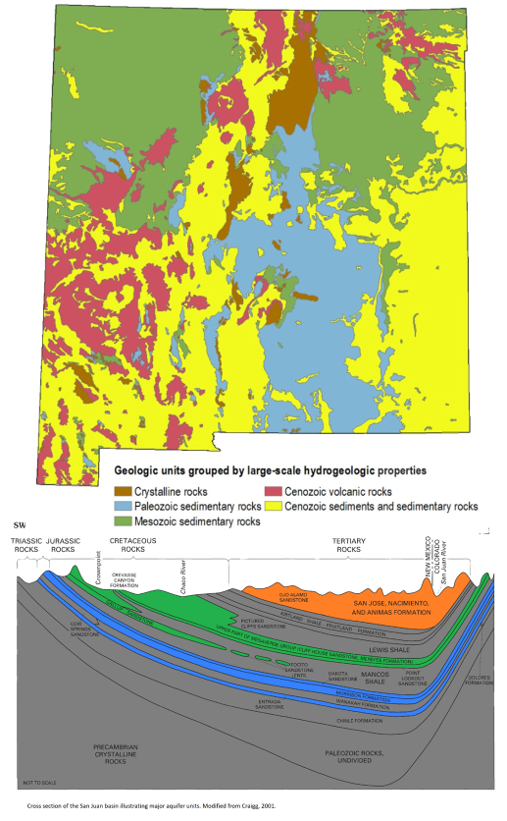
New Mexico’s Hydrogeology
Recommend less text
Highly diverse due to complex geology, hydrology and various Hydrogeologic Properties.
River-connected regions – Upper, Middle and Lower Rio Grande, San Juan, Pecos – Groundwater/Surface Water connectivity and conjunctive management
Non-river connected regions – Southern High Plains, Southwest, Central – In many of these basins water use exceeds recharge, leading to water level declines and finite aquifer life
Mixed regions – Northeast, Little Colorado
  Contain elements of river connected and non-connected systems
8

Slide 9
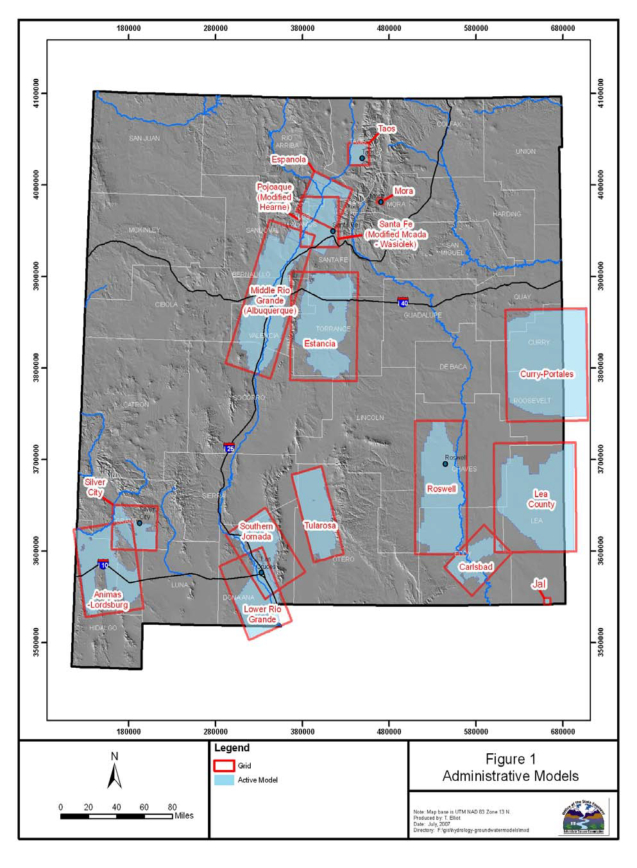
NM Needs Statewide Functional Groundwater Data
Aquifer Characterization – Aquifer extents (quantity) and boundary conditions, hydraulic properties, recharge, discharge, chemistry (water quality), etc.
Aquifer monitoring wells– Groundwater levels and water quality observed regularly over long periods of time through this well network.
Groundwater Use Metering – Well pumping records/meter readings. Only 45% of groundwater diversions are metered and only 35% of agricultural irrigation wells are metered.
Groundwater Modeling – Computer models representing aquifer dynamics responses to changing recharge and groundwater use.
Most of the state lacks characterization data, monitoring wells and models, with a few exceptions (Pecos Valley, Lower Rio Grande, High Plains). About 20 numerical administrative models (map), variable accuracy and forecasting ability due to foundational, monitoring, and need for metering data.
9
Notes:
~Most of the state lacks monitoring wells that have consistent long periods of record.
The New Mexico Bureau of Geology and Mineral Resources (NMGMR) conducts the state’s groundwater mapping and characterization studies.
These studies are extensive and cost a lot of money.
This funding would be a big step in the right direction for sustainable groundwater management in New Mexico.

Slide 10
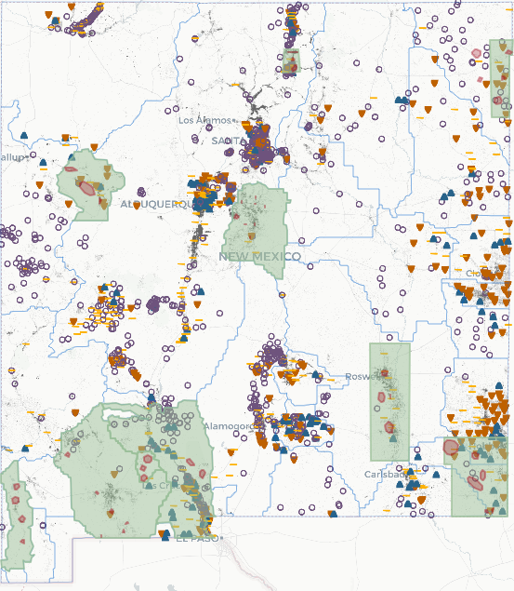
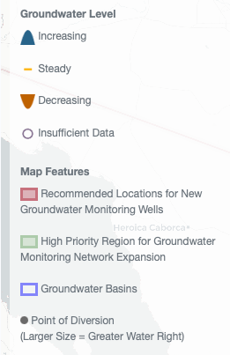
Groundwater declines reaching crisis levels in some areas of NM
  Aquifer drawdown threatens rural communities’ drinking water supply & agricultural economies.
10
Notes:
Groundwater declines reaching crisis levels
High Plains (Ogallala), Mimbres, Albuquerque, Estancia, etc.
Threatening agriculture and rural communities
Significant gaps in groundwater knowledge
Need for groundwater mapping, monitoring & metering
Ongoing & future challenges
Climate change, drought, PFAS, etc.
Basin Specific, Locally-driven Groundwater Management needed now
Need proactive groundwater management for aquifer longevity
Lessons learned from other states & tools/approaches for New Mexico

Slide 11
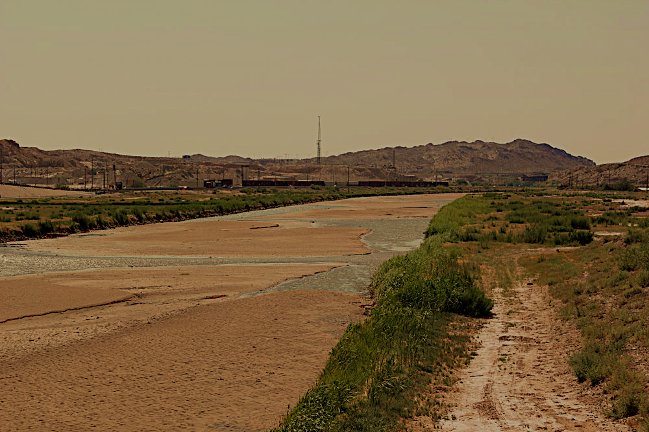
Current Groundwater Management Tools
Legal Tools:
Prior Appropriation Enforcement
OSE Well Permit Conditions & Protests
Metering Orders
OSE Criteria for Determination of Impairment
OSE Drawdown Standards
OSE Closure of Basins to New Appropriations
Regionalization of (Groundwater-dependent) Domestic Water Systems
11

Slide 12
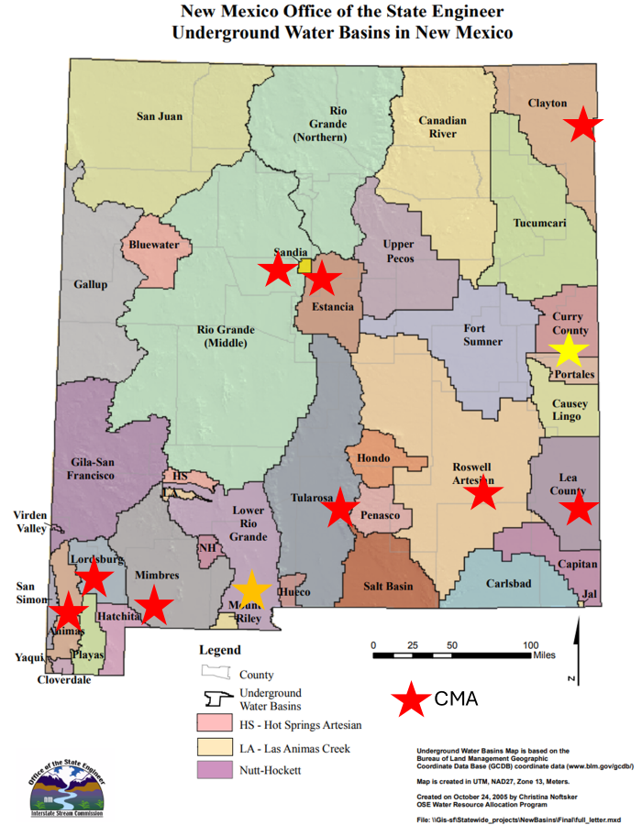
Managed Groundwater Declines – NM OSE GW Basin Designations
Closed Basins = no new appropriations allowed
Critical Management Areas (CMAs) are areas of excessive rates of water level declines – which trigger further use restrictions.
Most CMAs are on a 2040-2058 planning horizon (40 years).
  Aquifer management regulations don’t include parameters for when an aquifer is at the end of its useful life.
Addressing any impairment to existing rights as grounds for denial of new groundwater permits ~ would eliminate nearly all new water uses.
12
Notes:
The New Mexico Office of the State Engineer (NMOSE) can designate GW Basins as Closed or CMAs and assume jurisdiction over the appropriation and use of groundwater in that area, requiring permits for new wells and controlling water rights. Due to Basin conditions.
Example: Eastern Clayton Basin:
120 ft domestic water column
70% = 80ft allowable drawdown
2ft/yr for 40 years

Slide 13
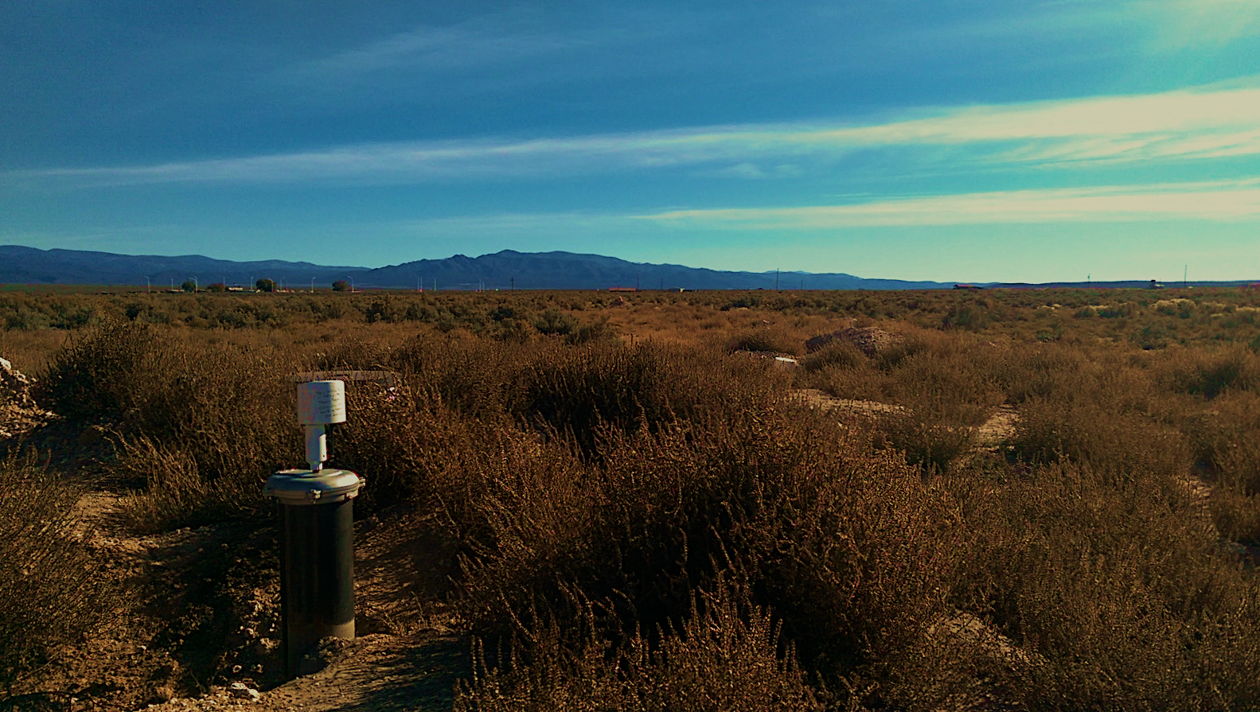
Current Groundwater Management Tools
Management Tools
ISC Buy & Dry Program (Lower Pecos Settlement)
Managed Recharge (ABCWUA) and Aquifer Storage & Recovery (ABCWUA & Rio Rancho)
Forbearance-Leasing Programs
Conservation Water Programs
Farm Bill Programs (CRP)
Streamflow Augmentation
Open ET = Remote Sensing
Graceful Failure
13

Slide 14
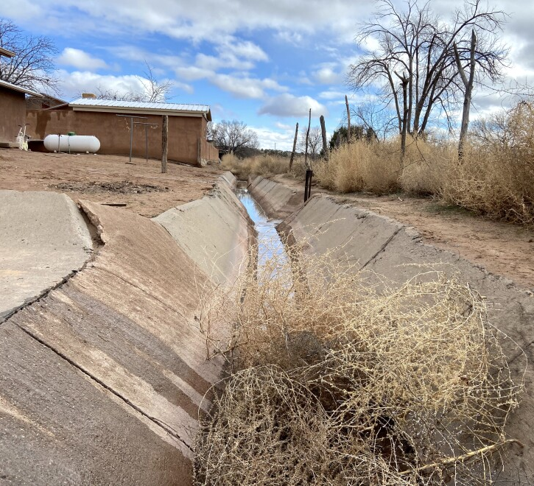
NM Communities Need Support:
Maintaining and securing future access to water (wells going dry)
Water Infrastructure & water quality needs
Funding Needs
Support Implementing water conservation
Planning for the future
Understanding regulatory requirements on water quality and quantity
Navigating the multiple state agencies involved in water management (water rights, infrastructure, quality…)
Notes:
Note what voices and how they were surveyed

Slide 15

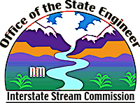
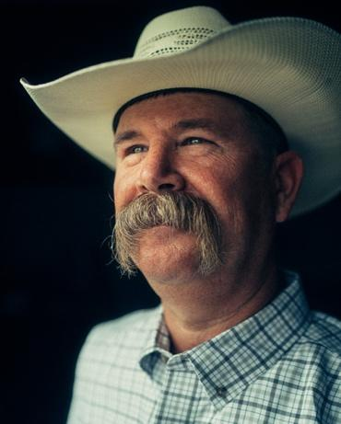

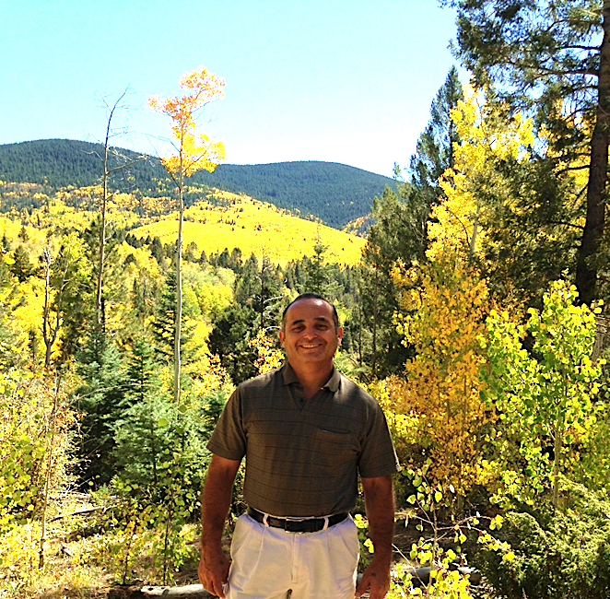
Local Groundwater Solutions in NM
Lower Rio Grande Groundwater Conservation Program
  ISC/OSE Voluntary grants compensates agricultural irrigators to stop irrigating to address Rio Grande Compact water deliveries
Cañada de Los Alamos Mutual Domestic Water Association
  Santa Fe County
  Proactive planning & community education; Water infrastructure financing and projects to protect the village’s strained water resources
High Plains (Ogallala) Aquifer and the Ogallala Land and Water Conservancy
  Curry County
  Voluntary, market-based model to conserve agricultural land and aquifer levels
Pecos Valley Artesian Conservancy District
  Chaves & Eddy Counties
  Adjudicated GW Rights and local governance with a funding mechanism to support water conservation/management in the Pecos
Notes:
“While not an exhaustive list of localized groundwater management in the state, these examples demonstrate the important components of effective groundwater management that are considered to meet sustainability goals with effective measures.”
under threat of a lawsuit -State Engineer began the water rights adjudication process.
Ten years later, and a reduction of 12,000 acres of irrigated agriculture, the court issued its final partial decree and ordered the PVACD to install and maintain a meter at every point of diversion (well) that had a water right. The decree also ordered PVACD to pay the expenses of the water master who would be responsible for the accounting of water.
A key component of the water conservation program included removing lands from agricultural production from Roswell to Carlsbad.

Slide 16
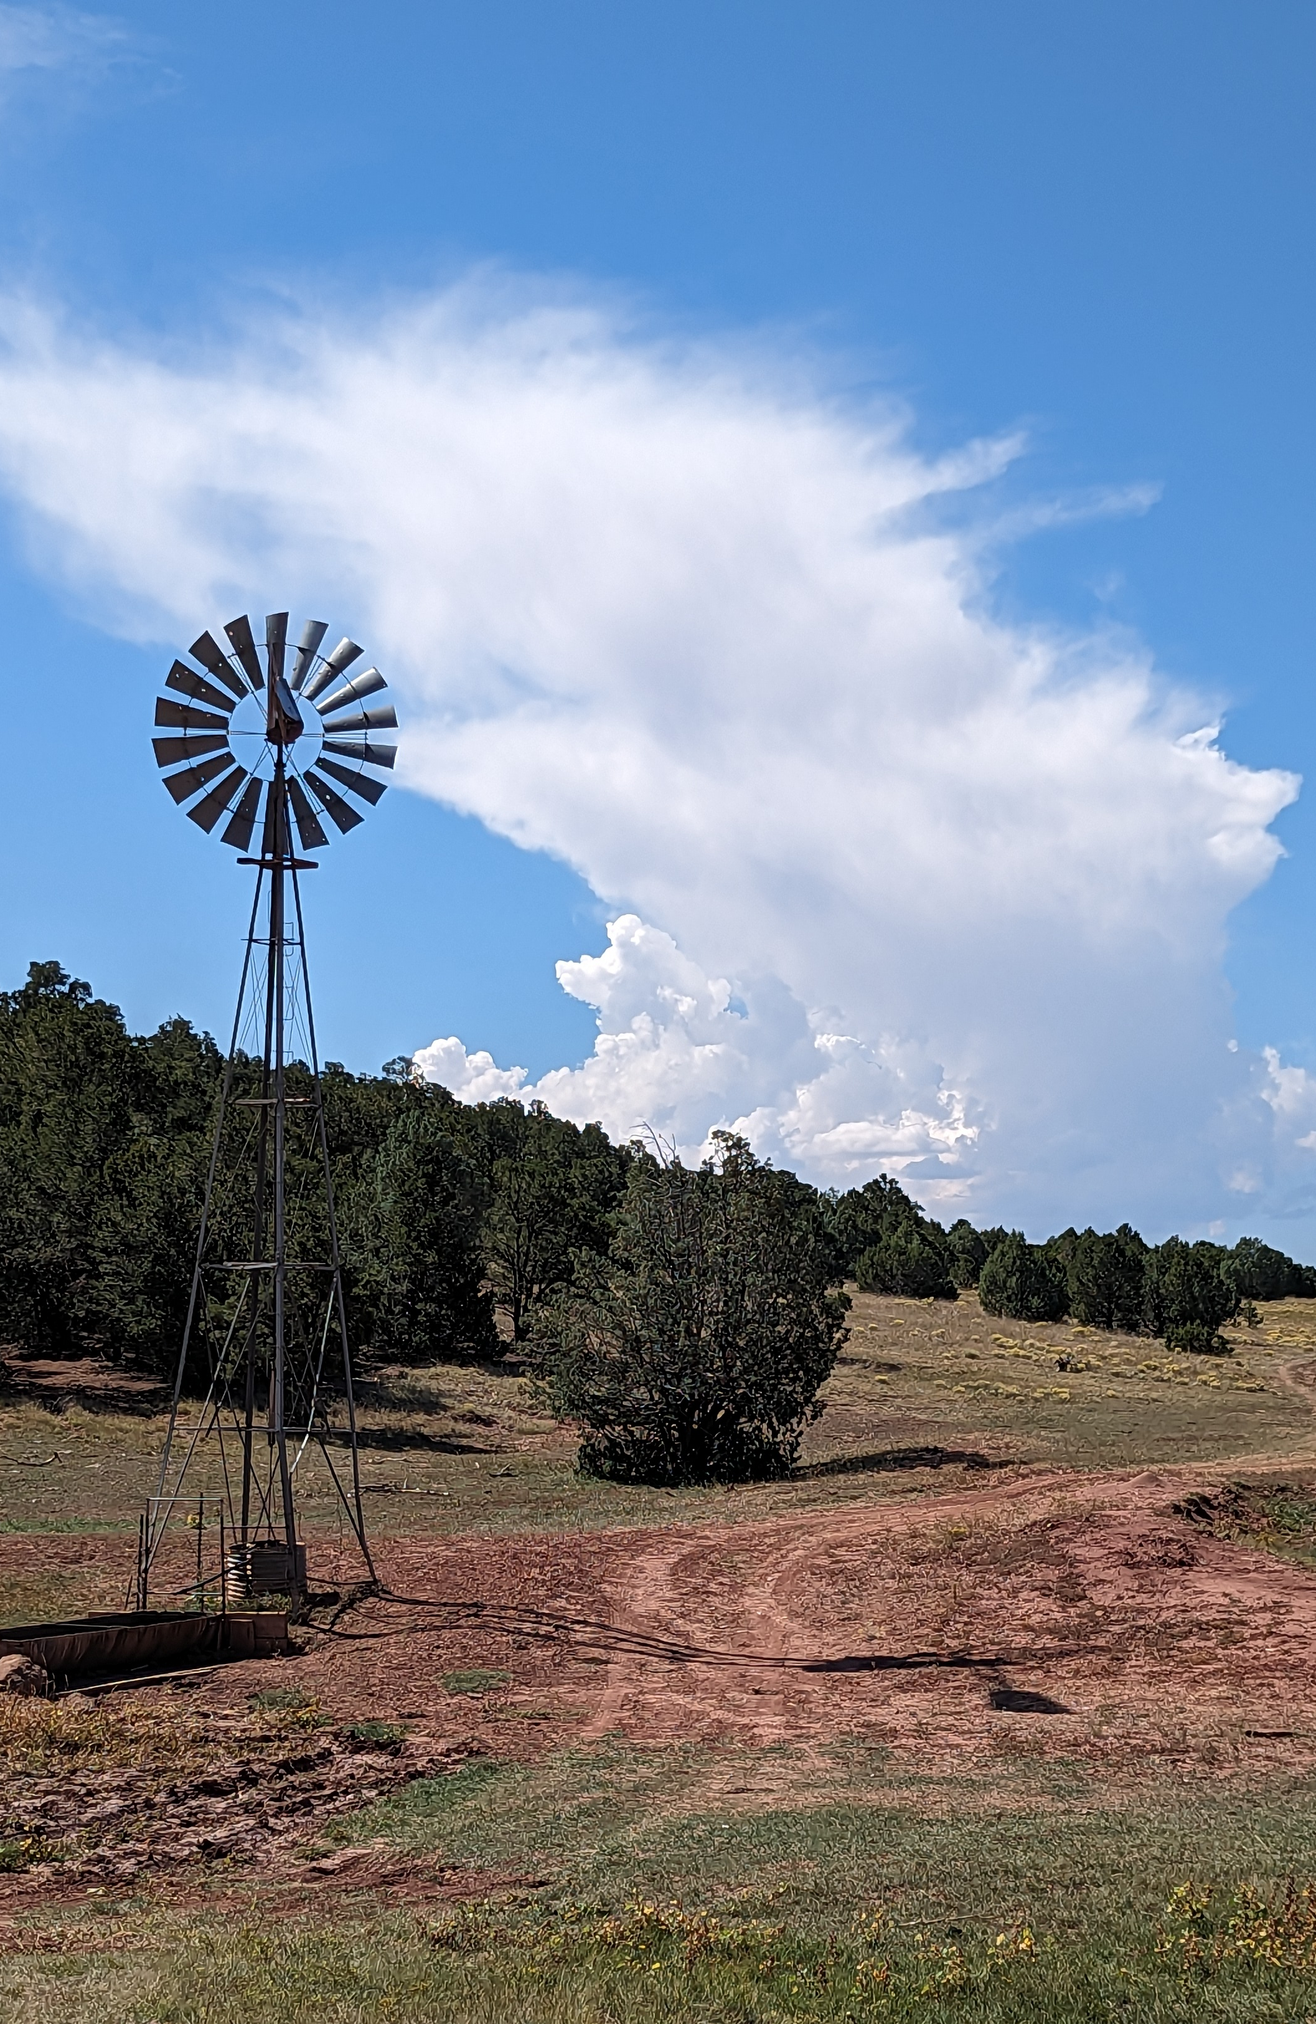
Recommendations for NM’s Groundwater Future
Treat Aquifers as Critical Infrastructure
Accelerate Aquifer Mapping, Monitoring, and Characterization
Expand Statewide Groundwater Metering
Expand Use of Evapotranspiration (ET) Data
Develop a Statewide Groundwater Management Framework to Guide Local Management
Support Community-Driven Groundwater Planning and Conservation with Robust Data and Tools
Notes:
Treat Aquifers as Critical Infrastructure
We have to invest in these aquifers –
understand them,
Maintain them
Protect them - from contamination – from over use
Accelerate Aquifer Mapping, Monitoring, and Characterization
Expand Statewide Groundwater Metering
The PVACD framework serves as a potential model for local scale management, where water users developed strategies to reduce depletions.
Metering provides needed metrics to avoid priority calls, curtailment, day-zero water crises and is critical information for developing place-based local strategies to lower net depletions.
The New Mexico Office of the State Engineer has the authority to issue metering requirements and will need support for capacity building (staff and equipment) for groundwater management.
Develop a Statewide Groundwater Management Framework to Guide Local Management
Enable Meaningful Engagement with Tribes, Pueblos, and Nations in Groundwater Policy and Management
Support Community-Driven Groundwater Planning and Conservation with Robust Data and Tools

Slide 17
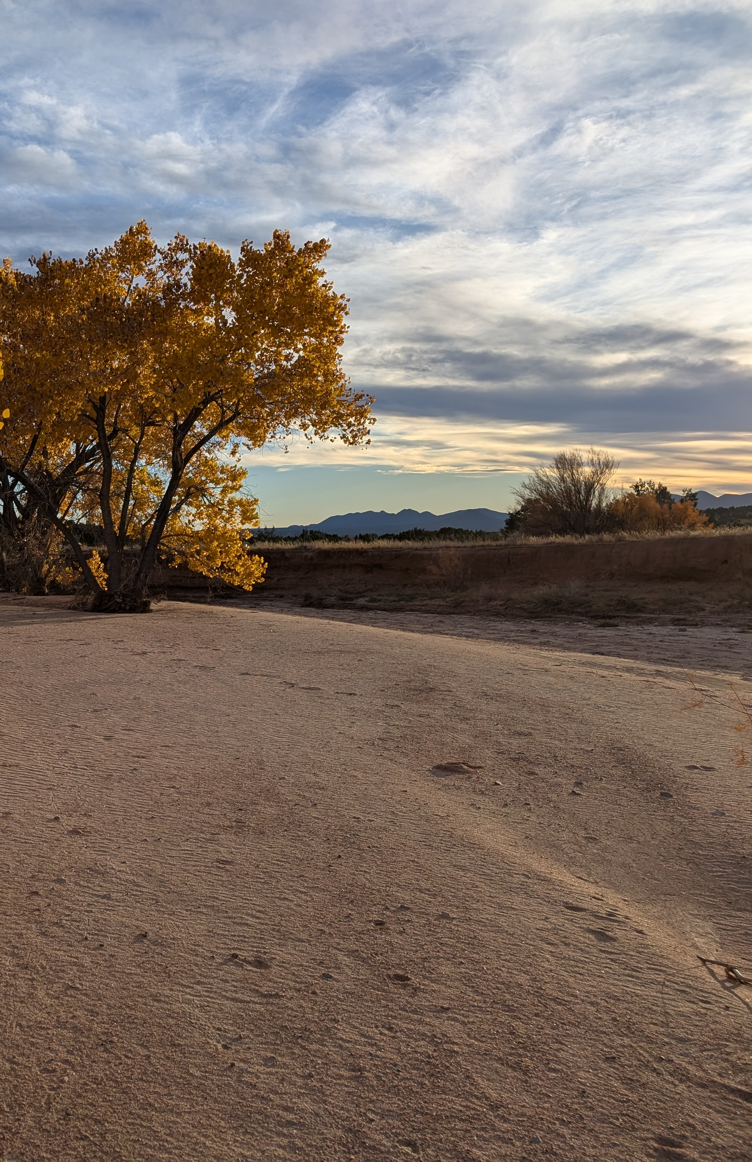
Recommendations for NM’s Groundwater Future
Enable Meaningful Engagement with Tribes, Pueblos, and Nations in Groundwater Policy and Management
Transparent Community Engagement and Education to Address Groundwater Concerns
Ensure that Groundwater is Appropriately Integrated in Regional Water Planning
Exercise Assertive Control/Limit New Groundwater Permits and Pumping
Provide Guidance for Conjunctive Management
Support and Expand Water Quality Monitoring
Notes:
Ensure that Groundwater is Fully Understood and Addressed in Regional Water Planning and other Community-Based Conservation Initiatives
Transparent Community Engagement and Education to Address Groundwater Concerns
Expand Use of Evapotranspiration (ET) Data
Control/Limit New Groundwater Permits and Pumping
Provide Guidance for Conjunctive Management
Support and Expand Water Quality Monitoring

Slide 18
Big Takeaways for NM’s Groundwater Future
Prepare for climate change and long-term water security without over depleting groundwater resources.
Fund, Support and Accelerate the Aquifer Mapping Program at NMBGMR to provide much needed groundwater data.
Treat aquifers as critical infrastructure
Accelerate groundwater metering and monitoring
Promote & support Tribal & Pueblo outreach for leadership in groundwater management strategies
Expand use of evapotranspiration (ET) data
Develop statewide framework to modernize governance of groundwater and guide local management for longevity
Groundwater
management requires
ongoing
investments!
Notes:
Prepare for climate change and long-term water security without over depleting groundwater resources.
Fund/Support the Aquifer Mapping Program at NMBGMR to provide much needed groundwater data.
Treat aquifers as critical infrastructure
Accelerate aquifer mapping and monitoring
Accelerate groundwater metering
Promote & support Tribal & Pueblo outreach for leadership in groundwater management strategies
Expand use of evapotranspiration (ET) data
Develop statewide framework to guide local groundwater management
Modernize Local Groundwater Governance to help local communities effectively manage groundwater for longevity.

Slide 19

Thank you!
Gretel Follingstad, PhD
Senior Manager, Climate Resilient Water Systems
Environmental Defense Fund
gfollingstad@edf.org
C 505-603-5402 (MT)
19

